Slide 1



MARTINSVILLE redevelopment EFFORTS

Slide 2

INTRODUCTION
TARVARIS J. McCOY
THE REAL MCCOY COMPANIES

Slide 3
Median income/ affordability - martinsville
MSA MEDIAN INCOME $70,600 (HUD PUBLISHED INCOME LIMITS)
CITY MEDIAN INCOME $36,832 (US CENSUS BUREAU)
HOME AFFORDABILITY $118,000 (BASED ON 30YR MTG AT 7% APR)
RENT AFFORDABILITY $920 (BASED ON 30% RENT)

Slide 4
Virginia home building costs
Home Size ​ | Average Price
800 sq. ft. | $124,000
1,000 sq. ft. | $155,000
1,200 sq. ft. | $186,000
1,400 sq. ft. | $217,000
1,500 sq. ft. | $232,500
1,700 sq. ft. | $263,500
2,000 sq. ft. | $310,000
2,500 sq. ft. | $387,500

Slide 5
Five points development
CURRENT DEVELOPMENT

Slide 6
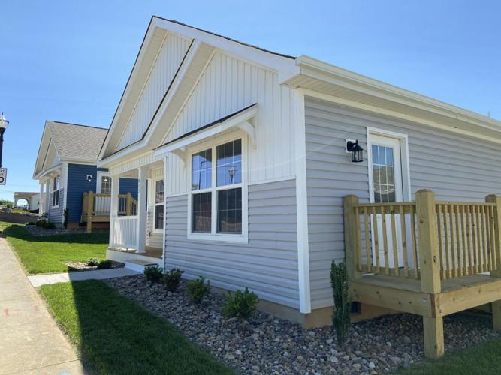
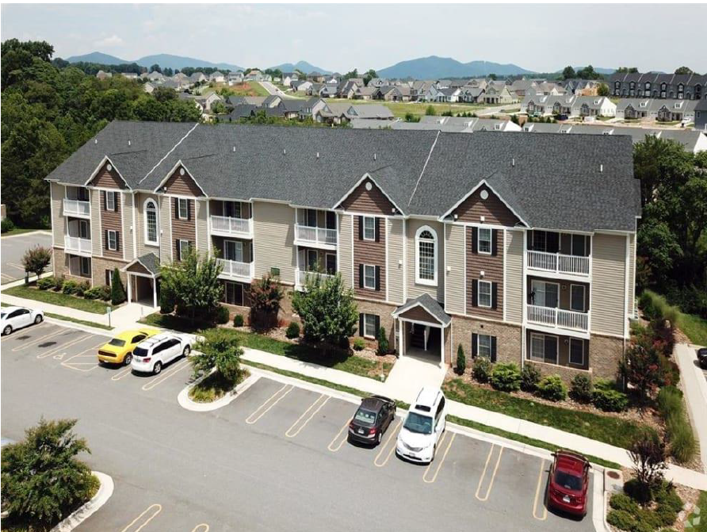
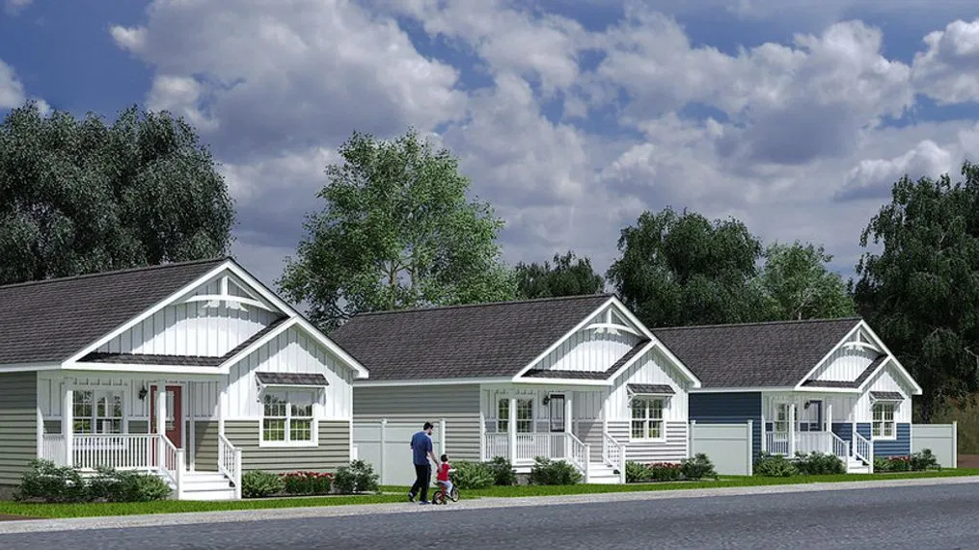
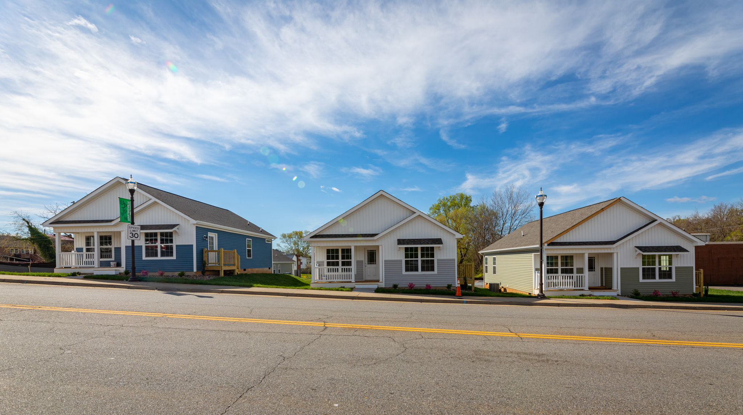
FIVE POINTS DEVELOPMENT

Slide 7
FIVE POINTS DEVELOPMENT
HIGH-QUALITY
Well-designed, enhances neighborhood
INNOVATIVE
Innovative building materials and process
AFFORDABLE
Will target families and households that need it
The project can help to stimulate long-term growth
SUSTAINABLE

Slide 8
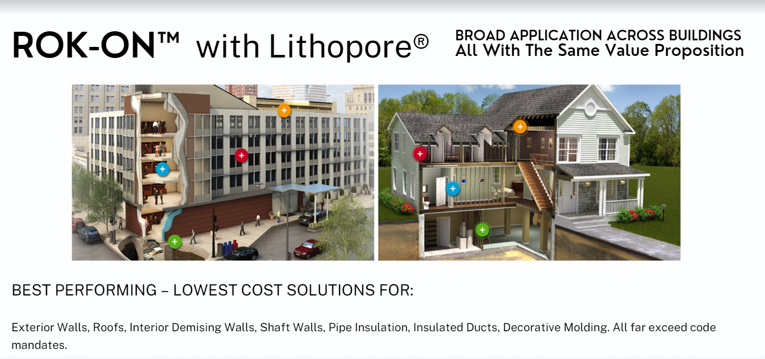
Five points apartments
2023
Predevelopment Initiated
2024 Q1
Predevelopment Completed
2024 Q2
Begin Construction

Slide 9
WHAT’S NEEDED?
SITE CONTROL
TAP FEES
PERMITTING FEES
TAX ABATEMENT

Slide 10
42 Acres site rives road
FUTURE DEVELOPMENT

Slide 11
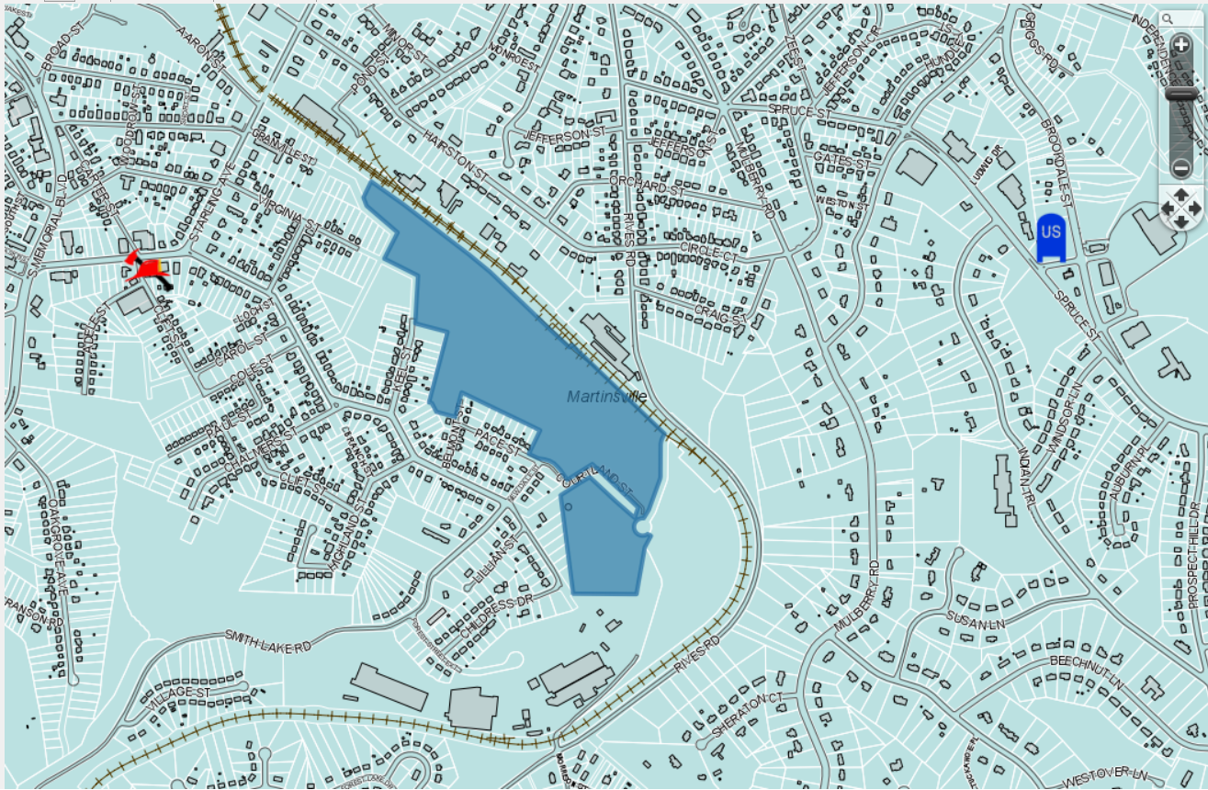
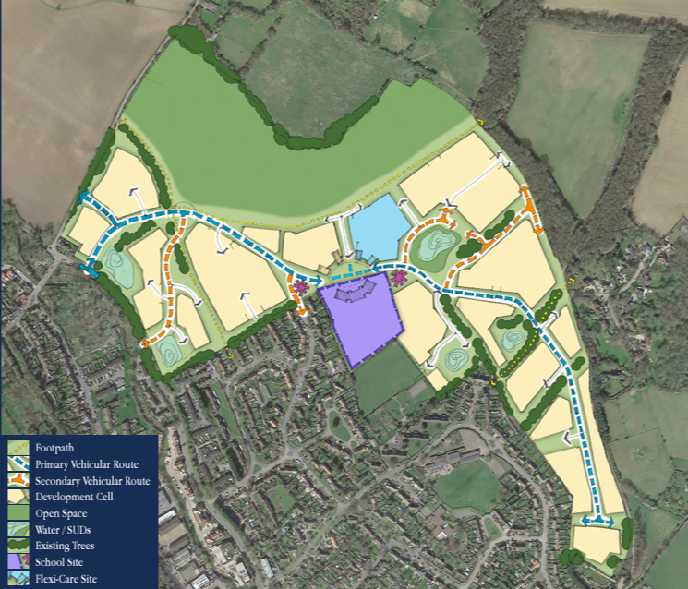
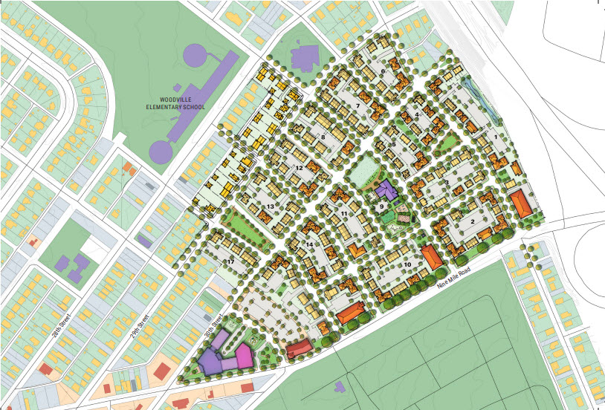
Planned Development
Rives Road
Step 1
Step 2

Slide 12
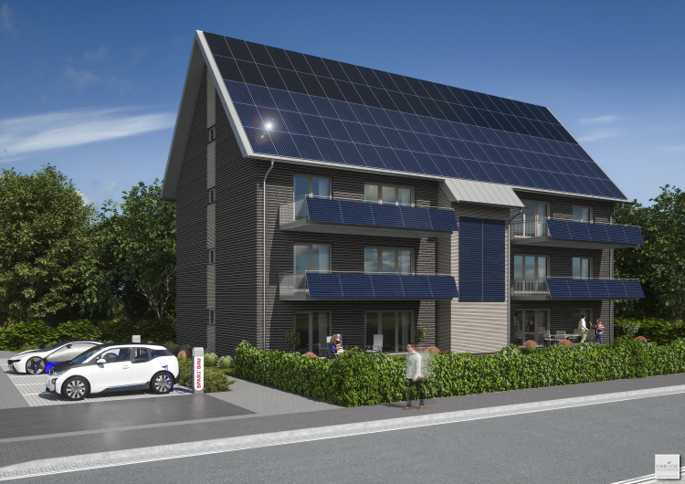
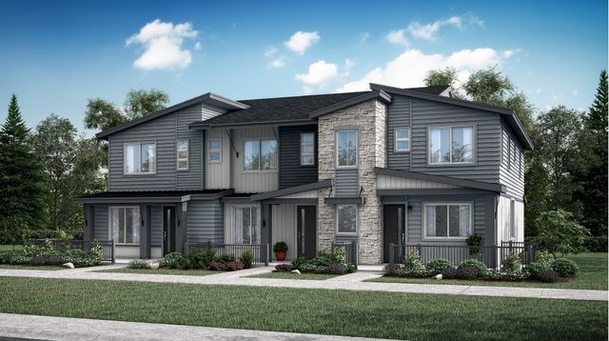
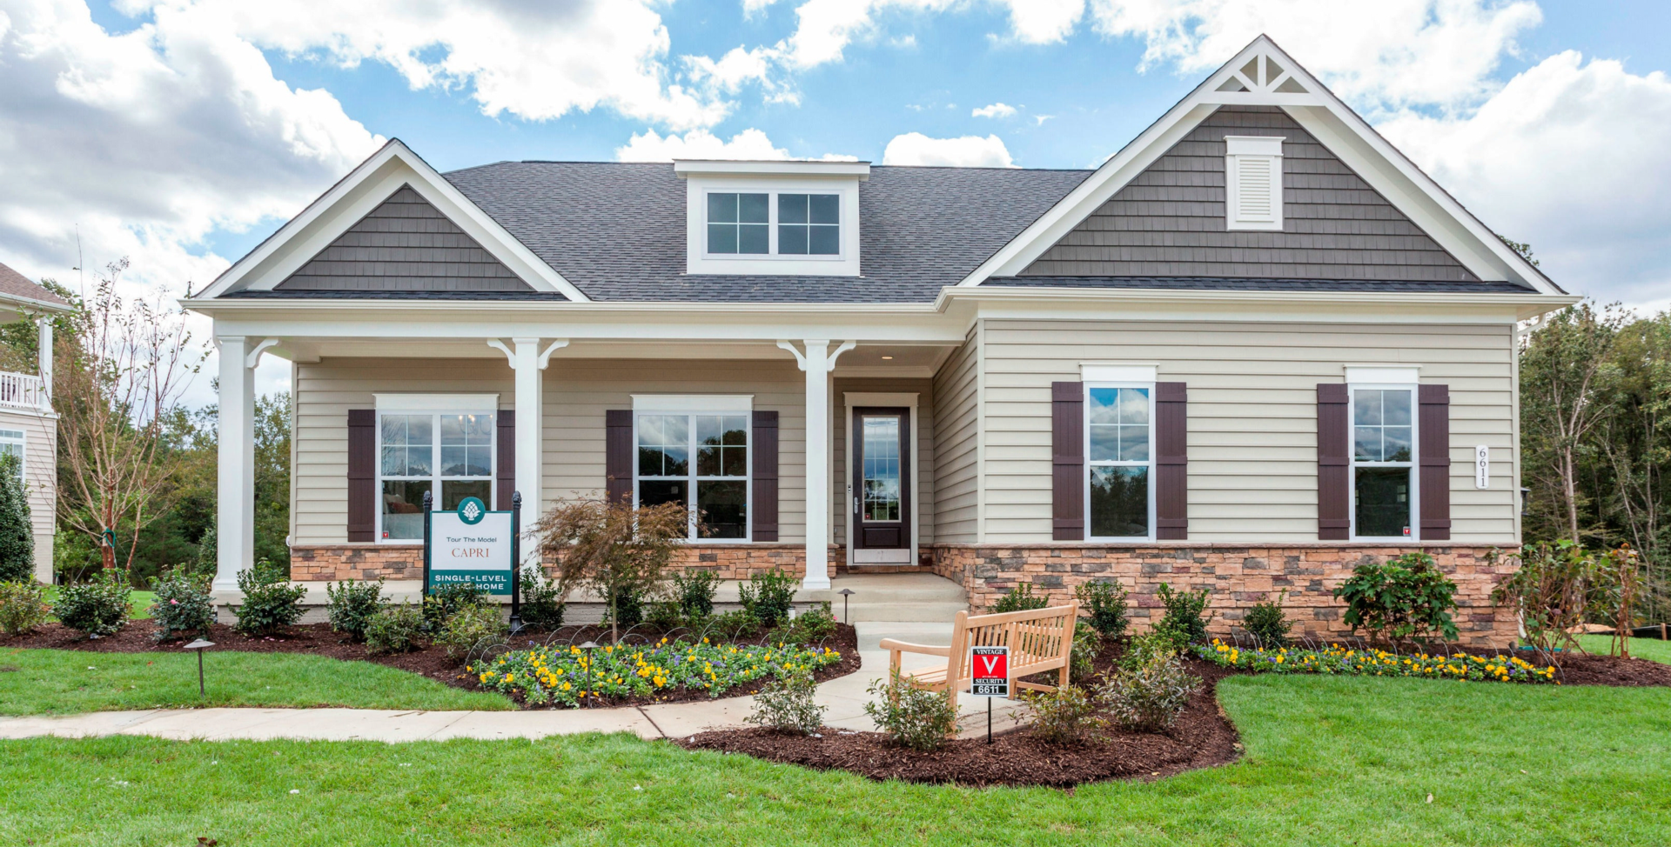
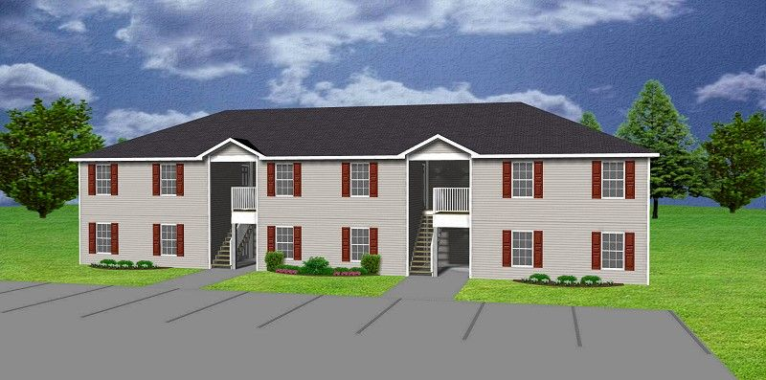
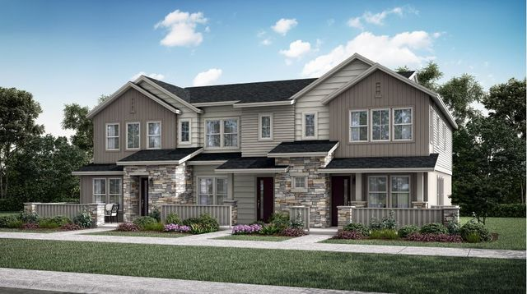
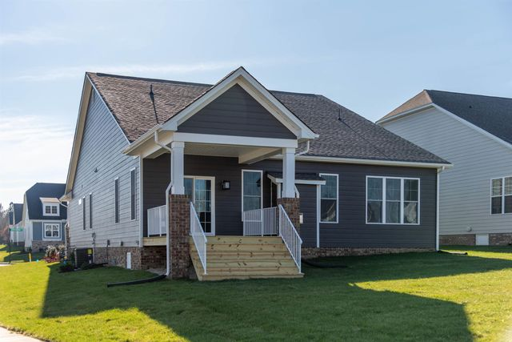
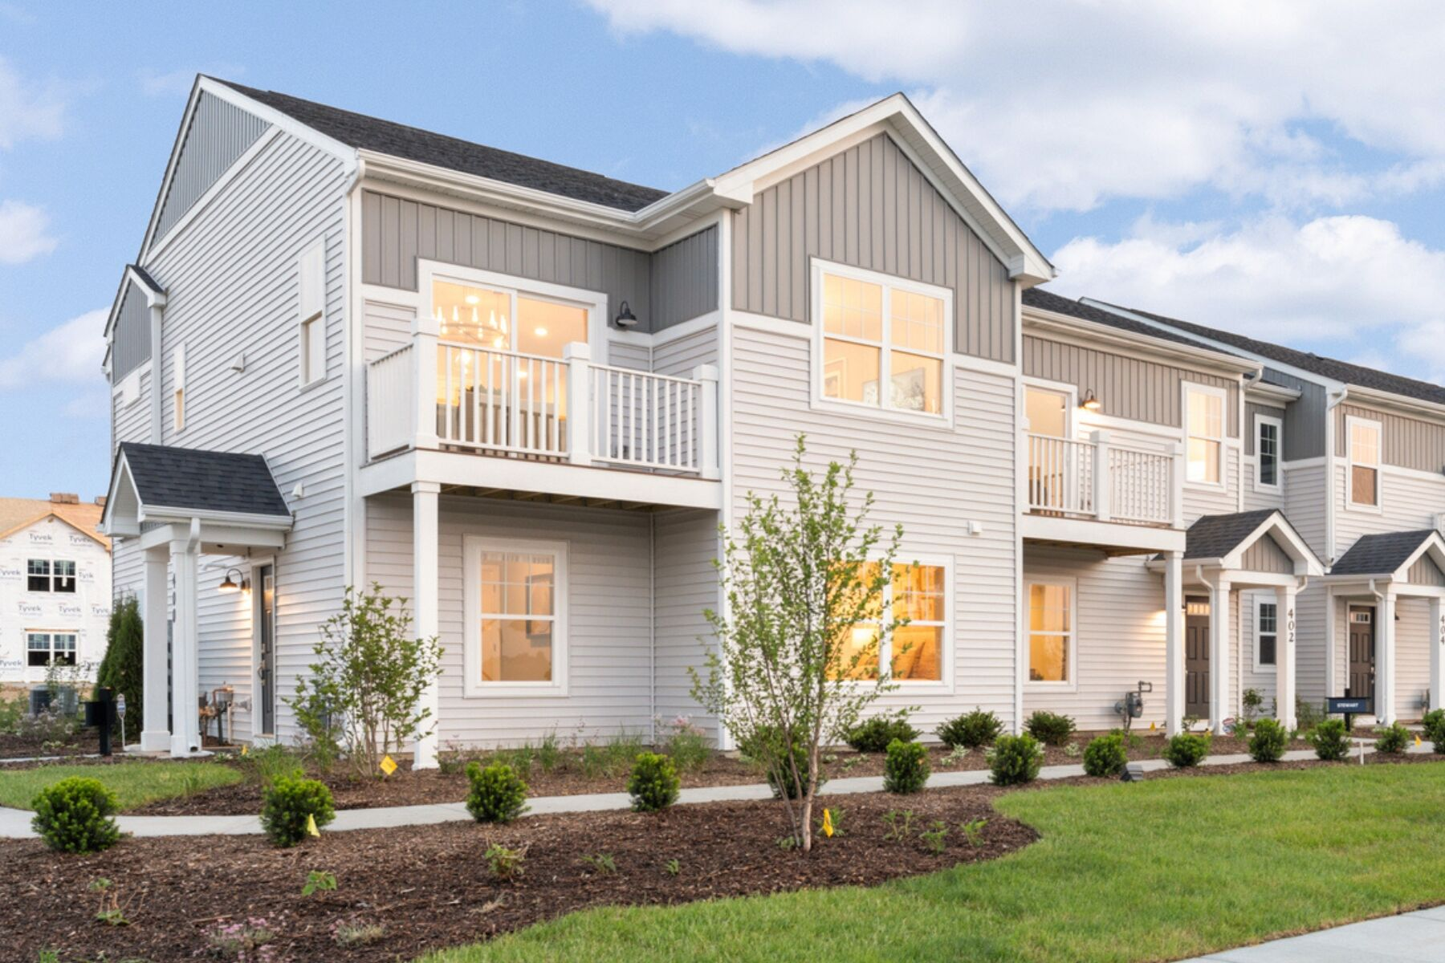
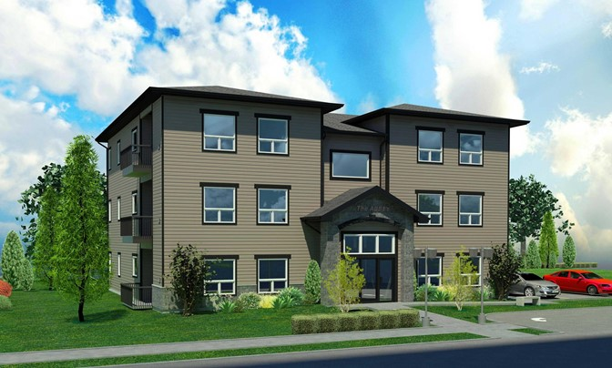
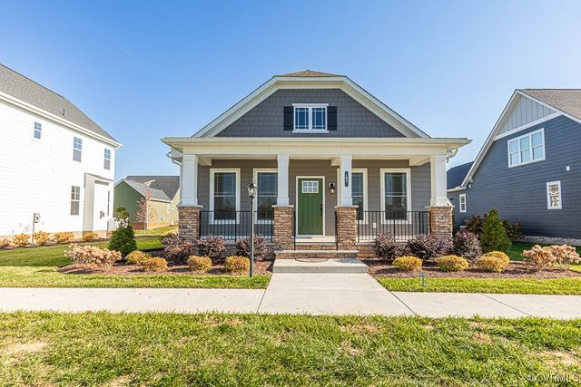
Planned Development
Rives Road

Slide 13
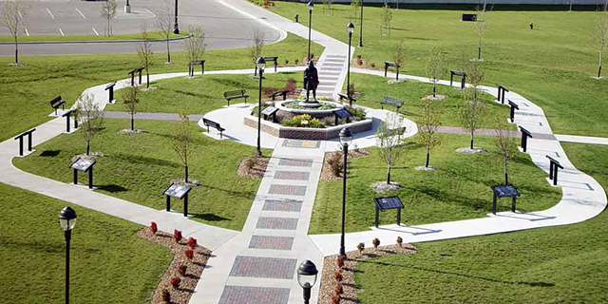
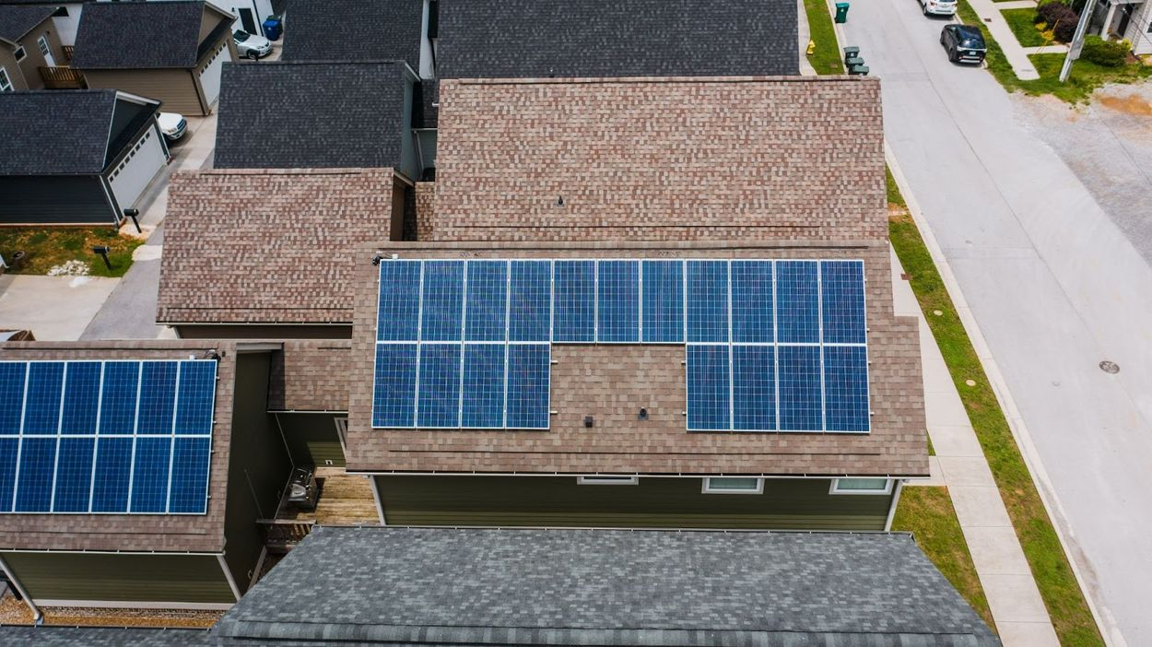
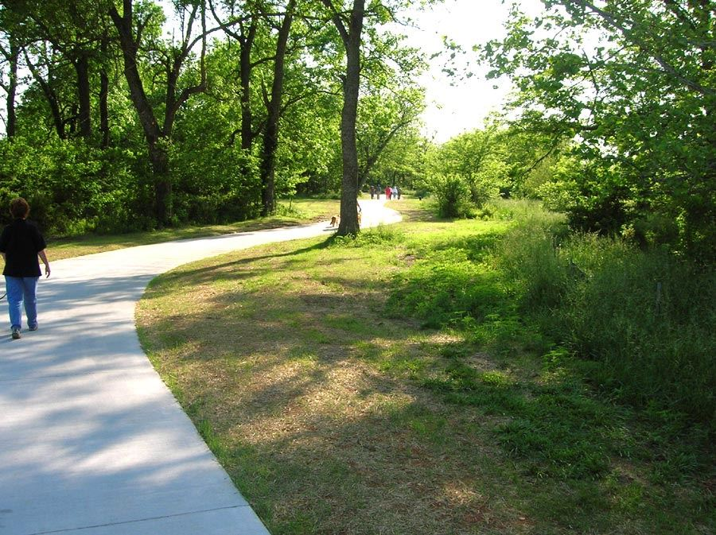
Planned Development
Rives Road
WHAT’S NEEDED?
SITE CONTROL

