Slide 1

School Zone Safety Ordinance Proposal

Slide 2
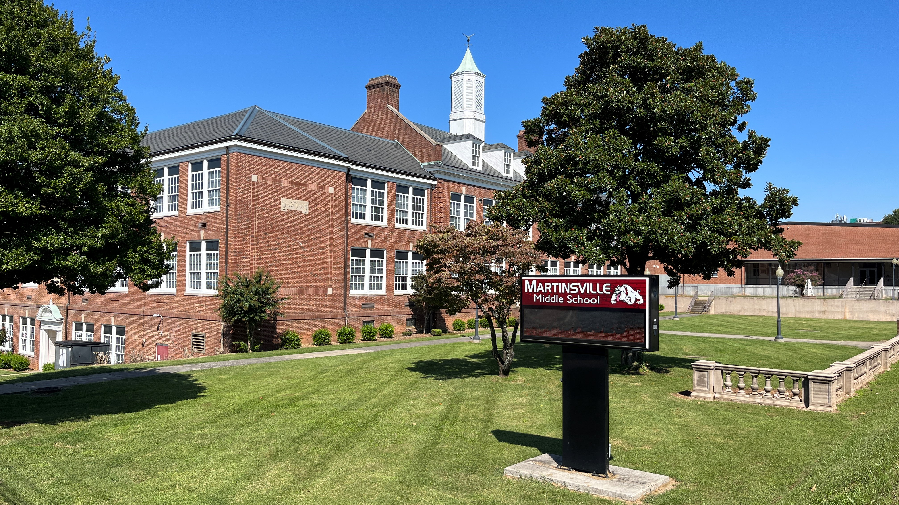
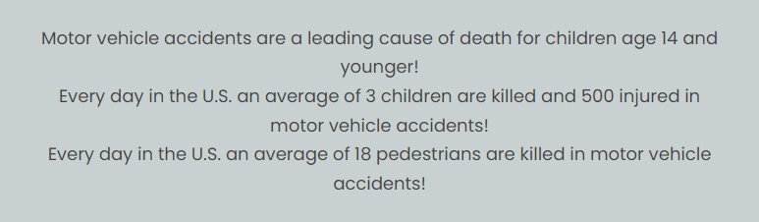

Slide 3
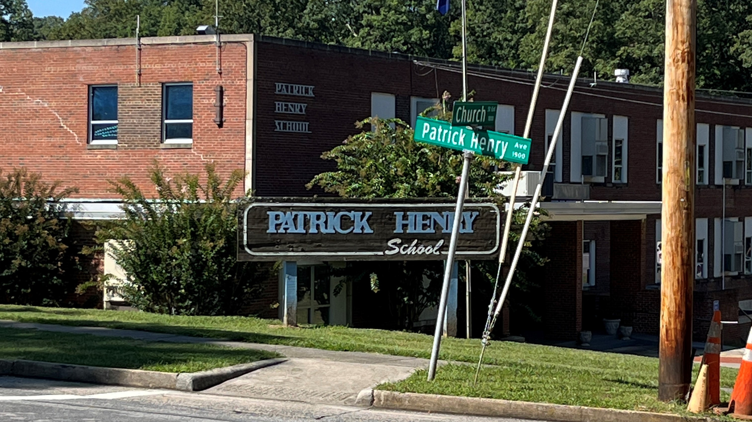
With these facts in mind we must examine areas of potential danger and methods to prevent a tragedy from occurring.
The reduced speed school zones are areas that we can take proactive measures to reduce these risks.

Slide 4
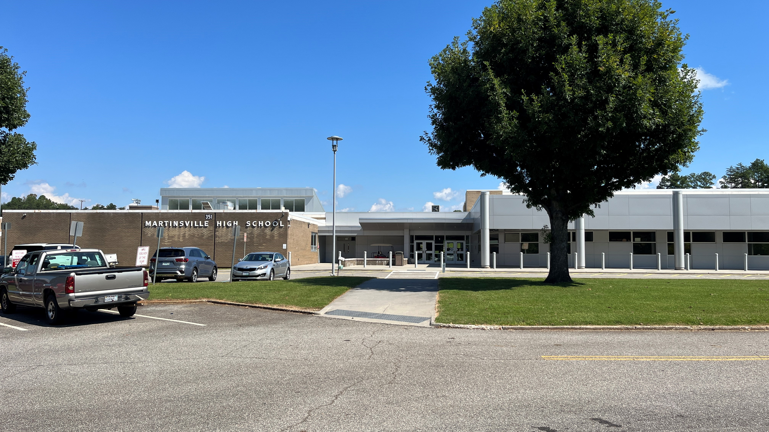
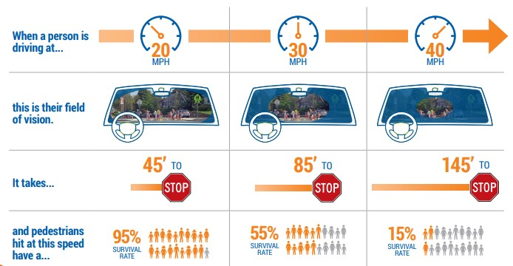

Slide 5
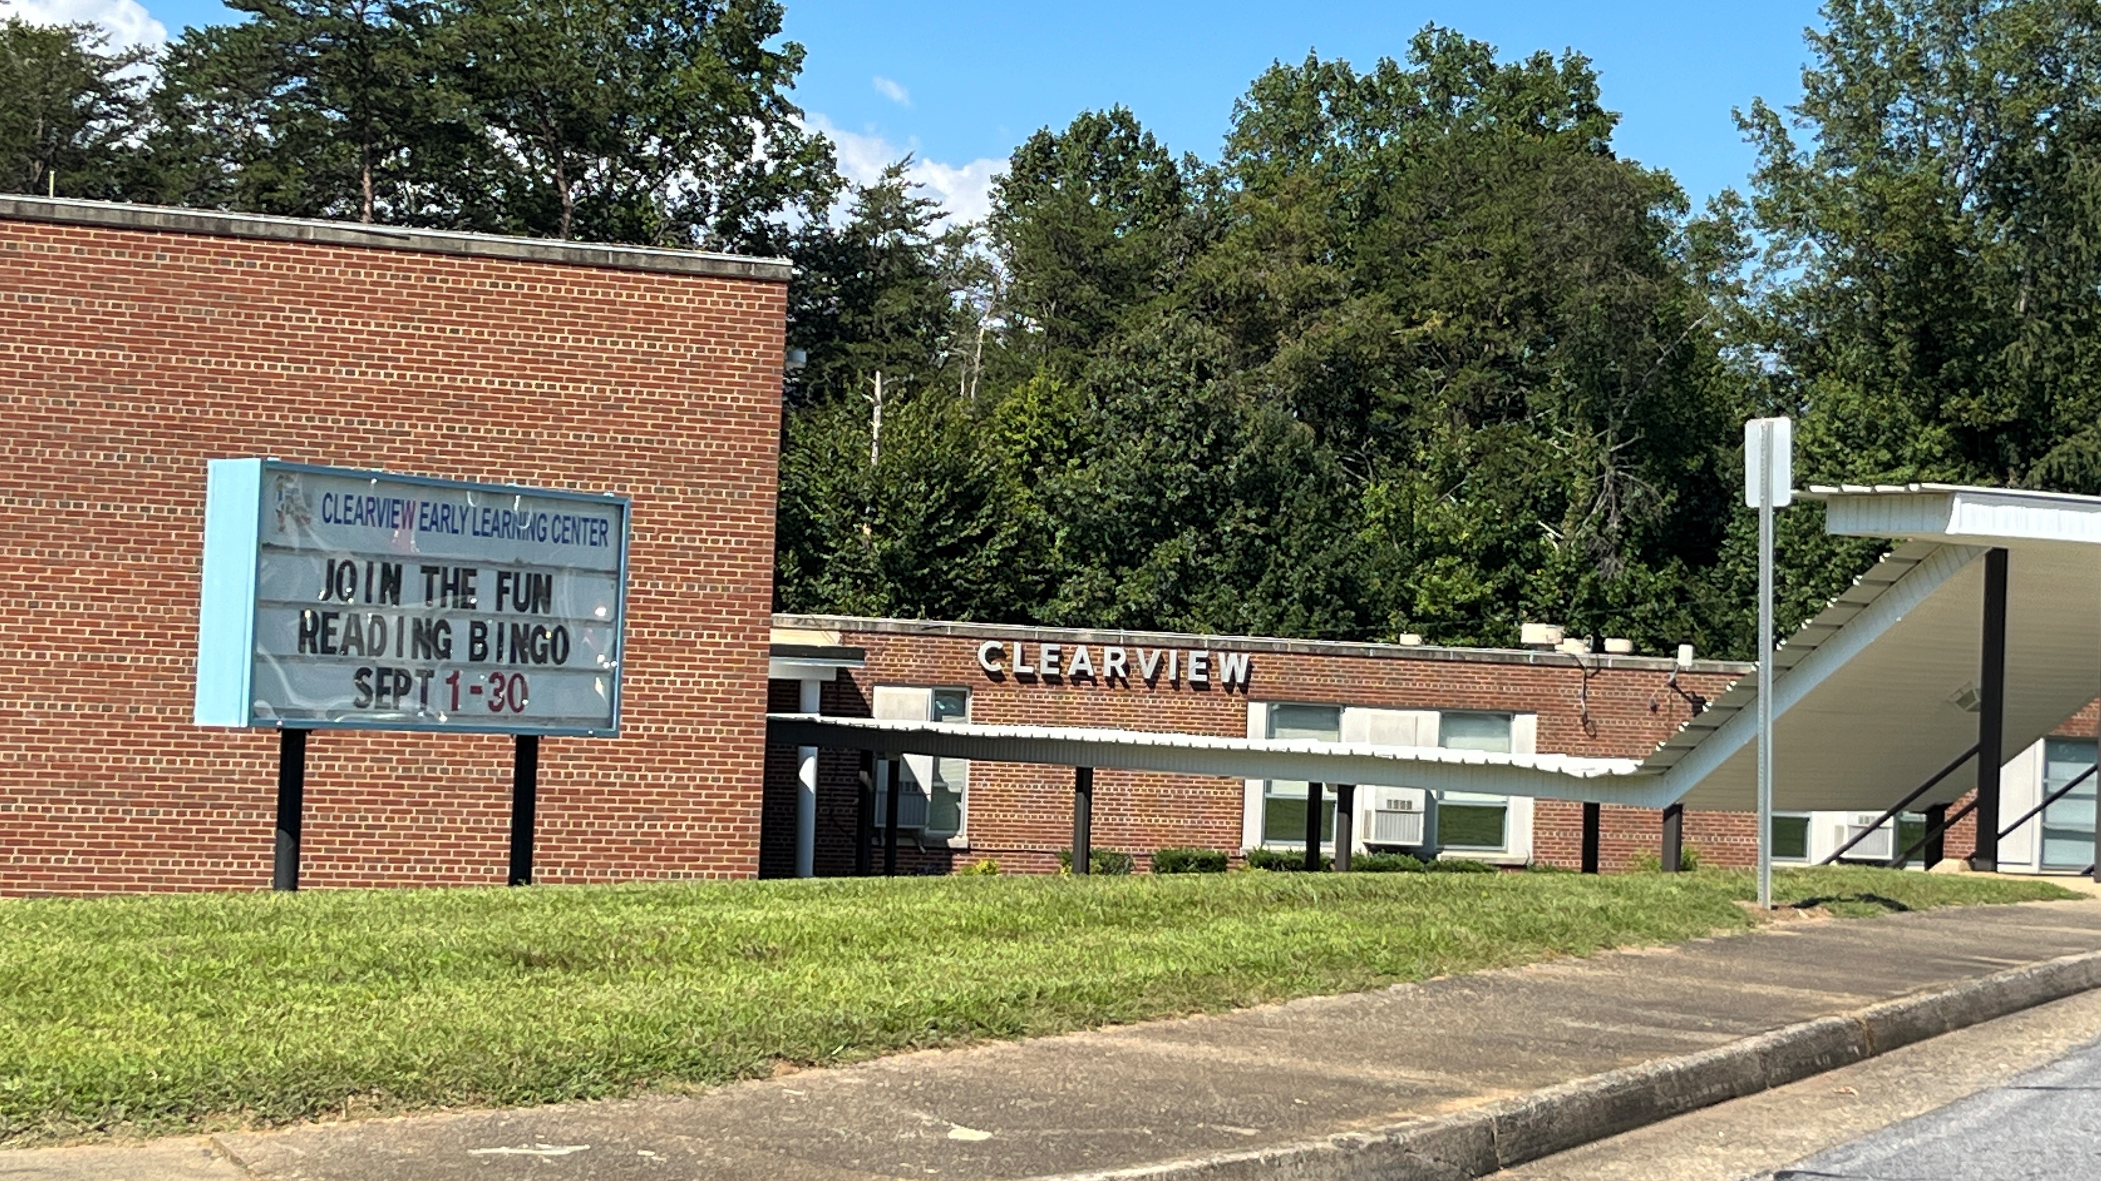
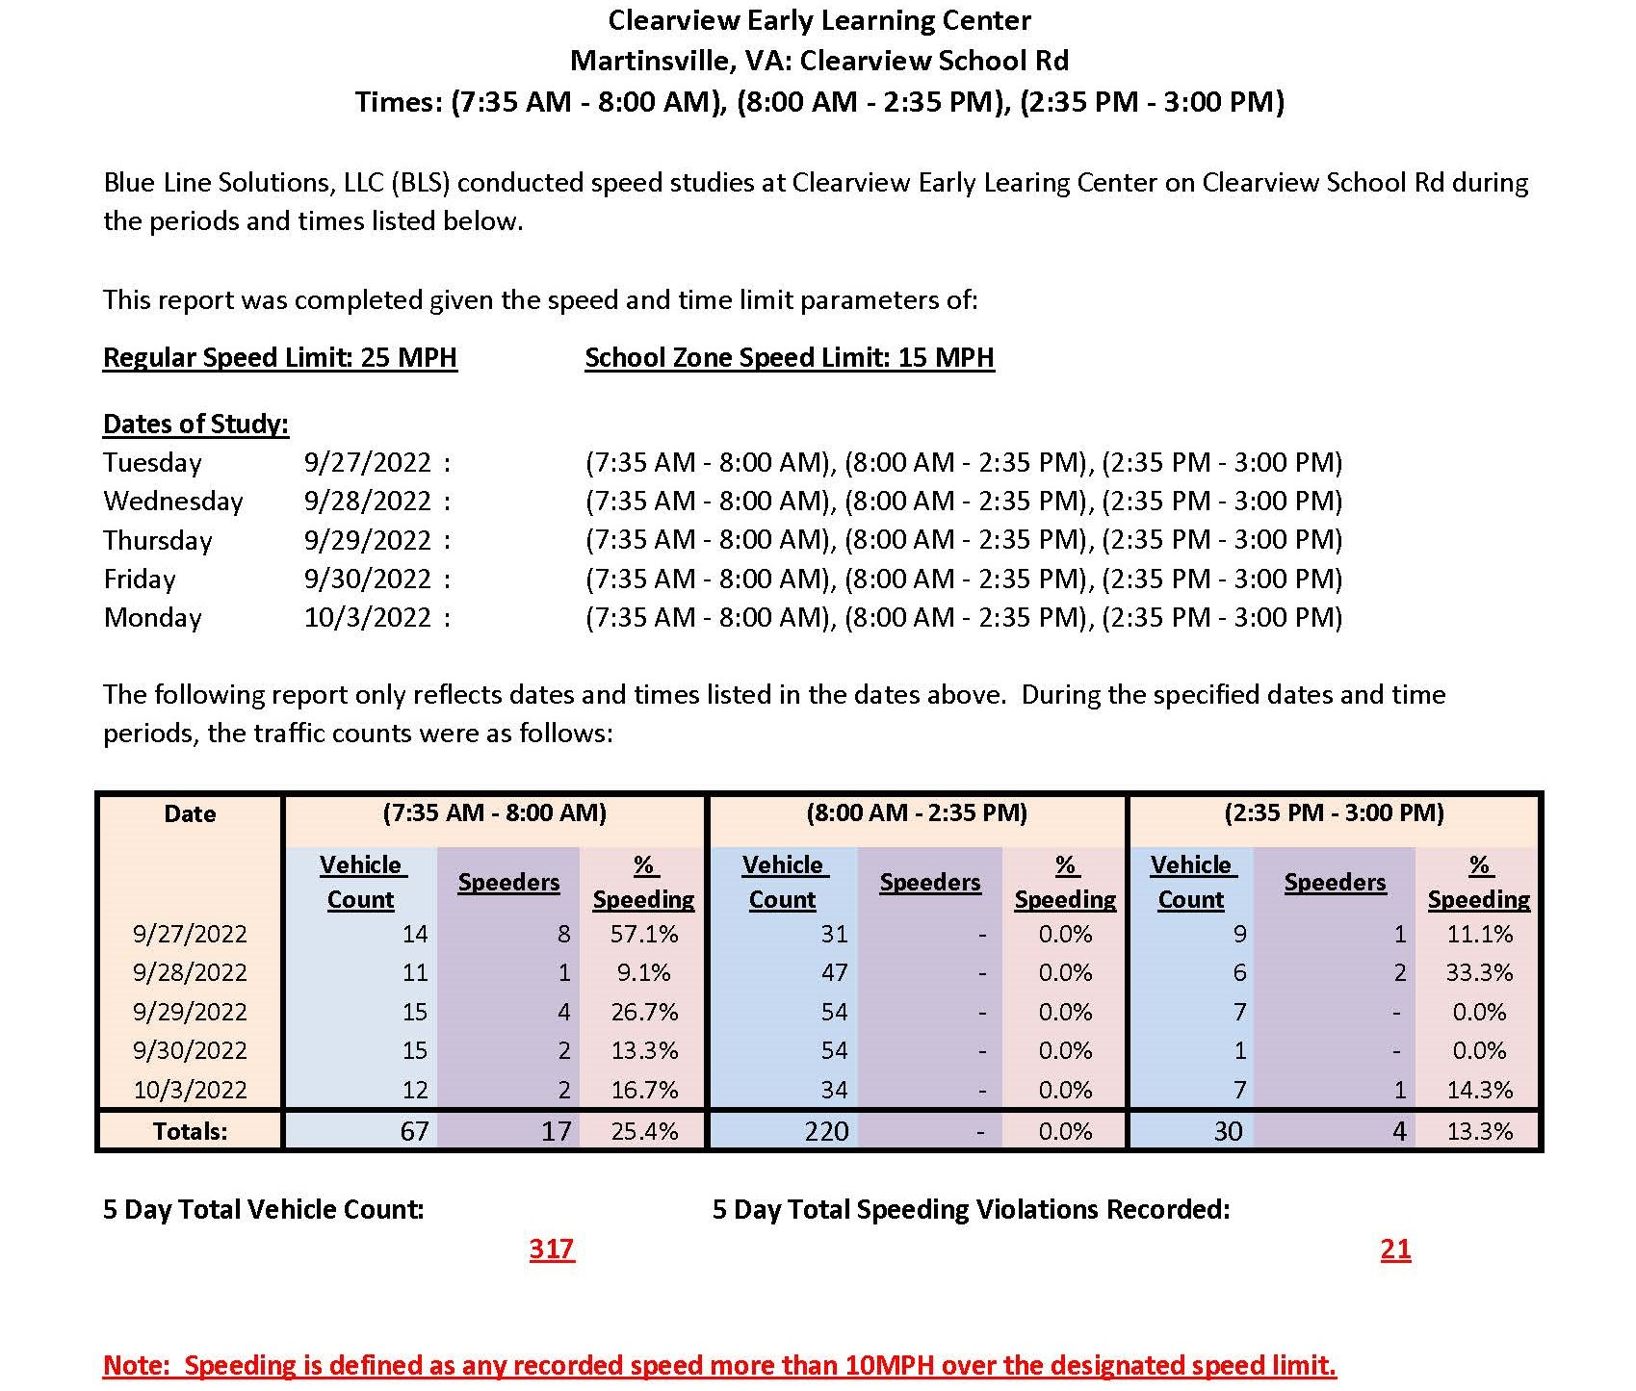
Traffic Data at Martinsville Schools

Slide 6
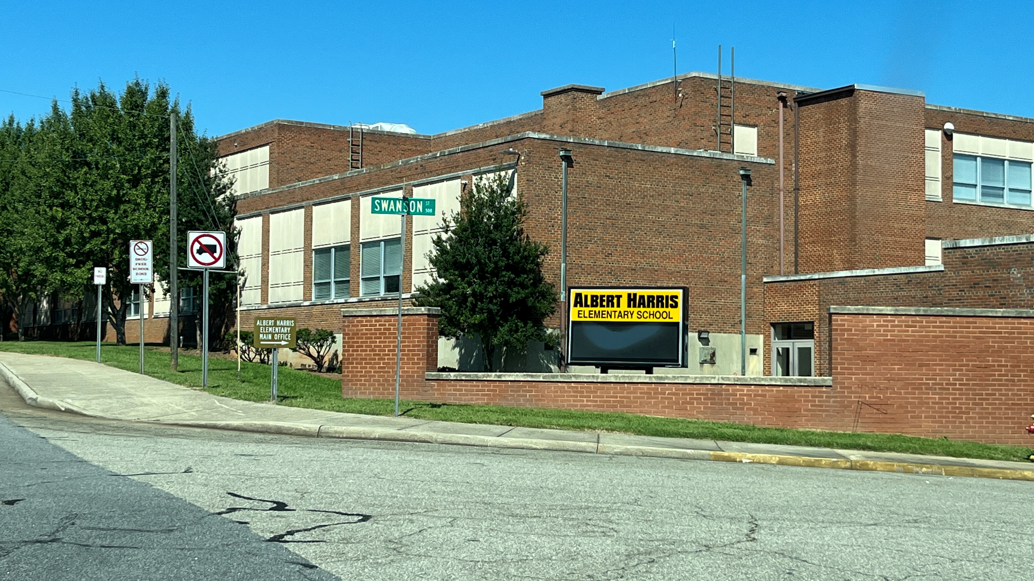
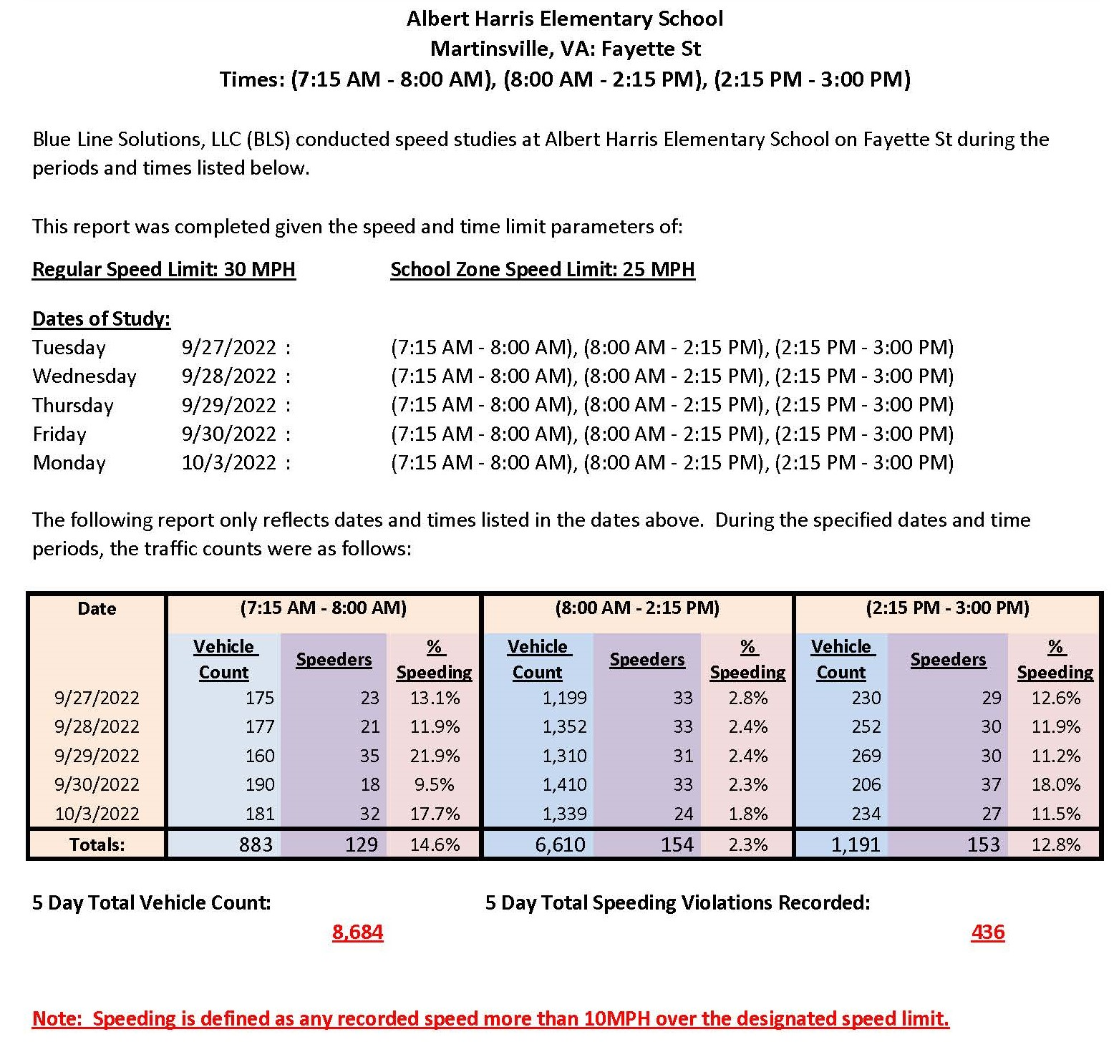
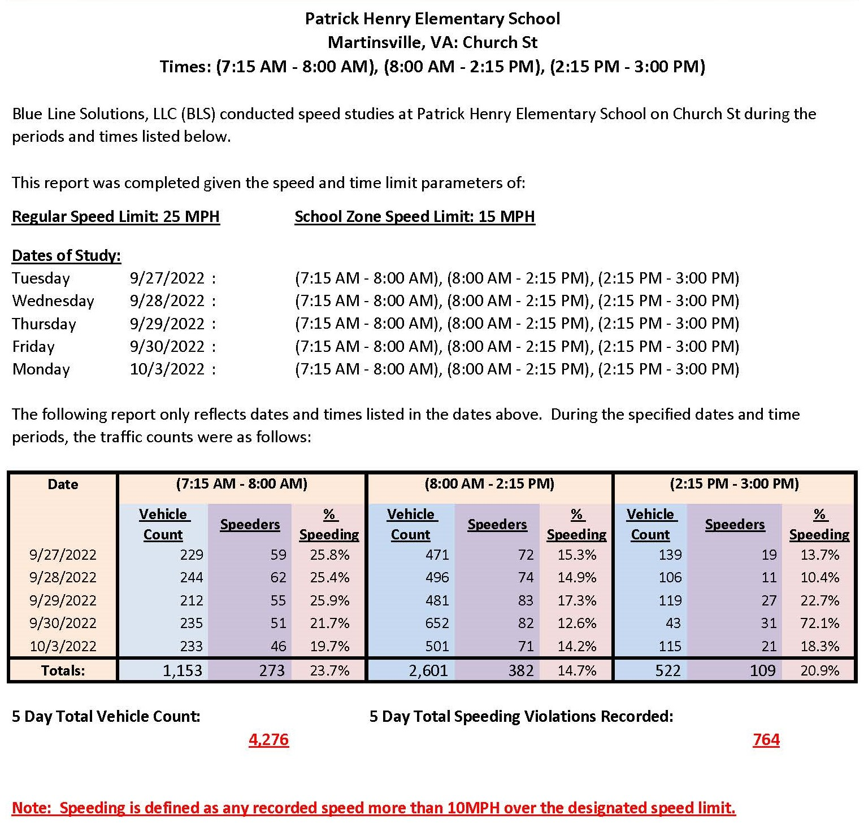
Traffic Data at Martinsville Schools

Slide 7
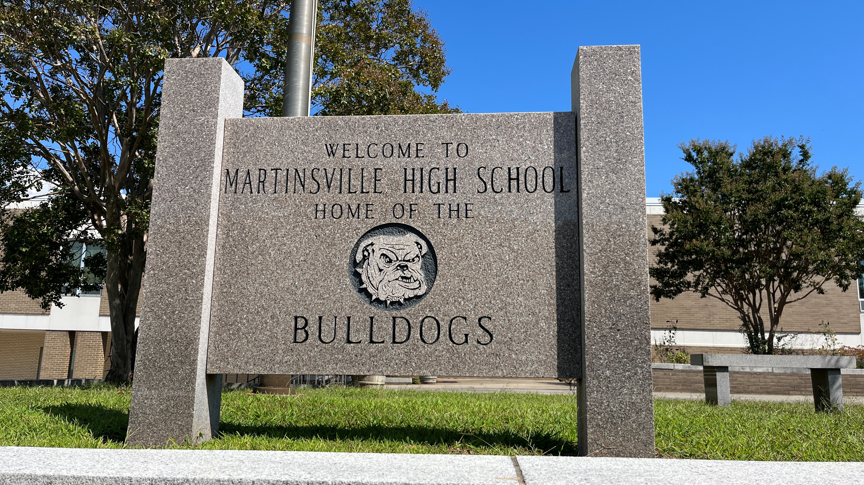
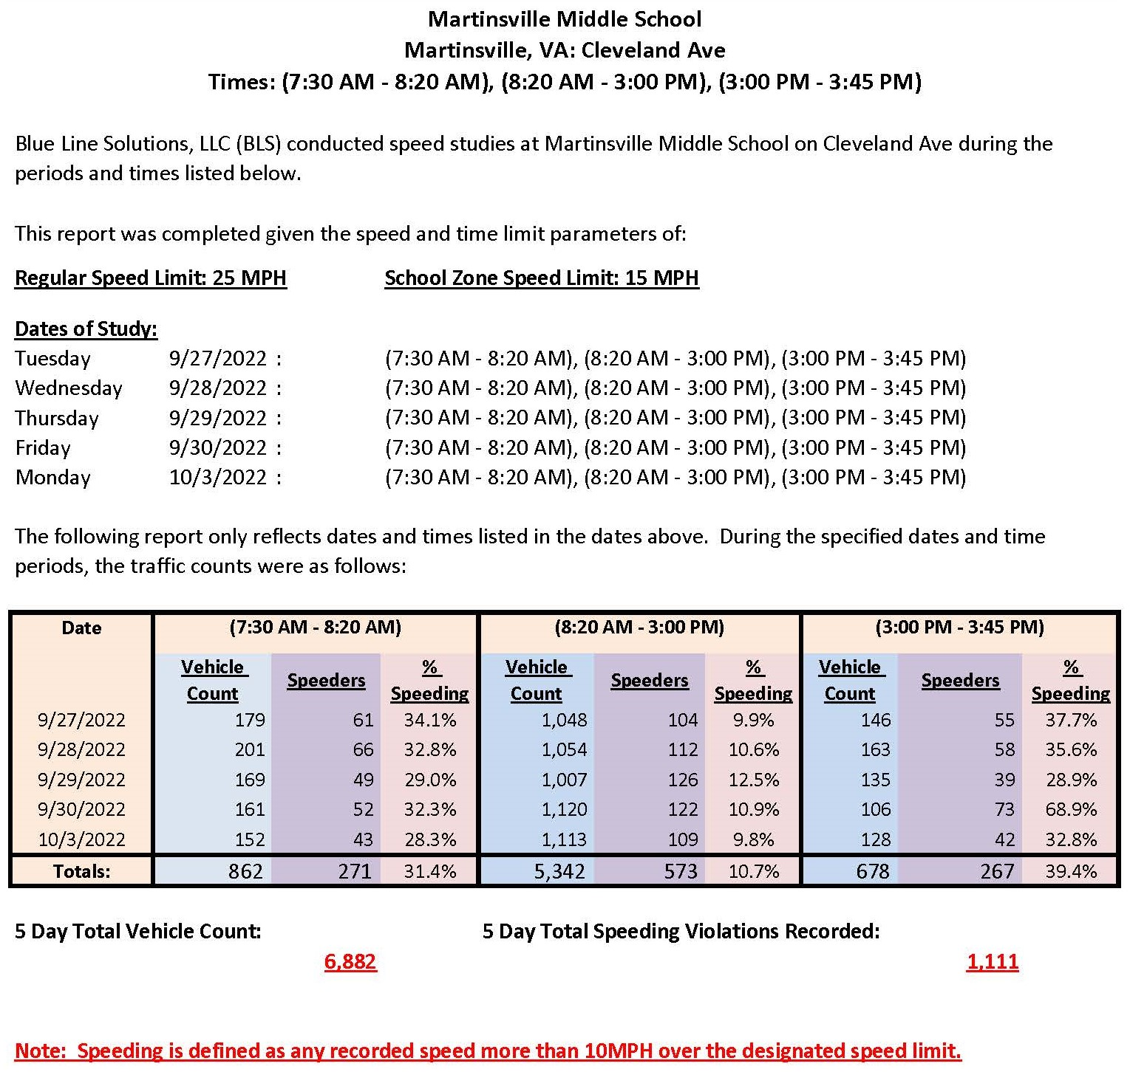
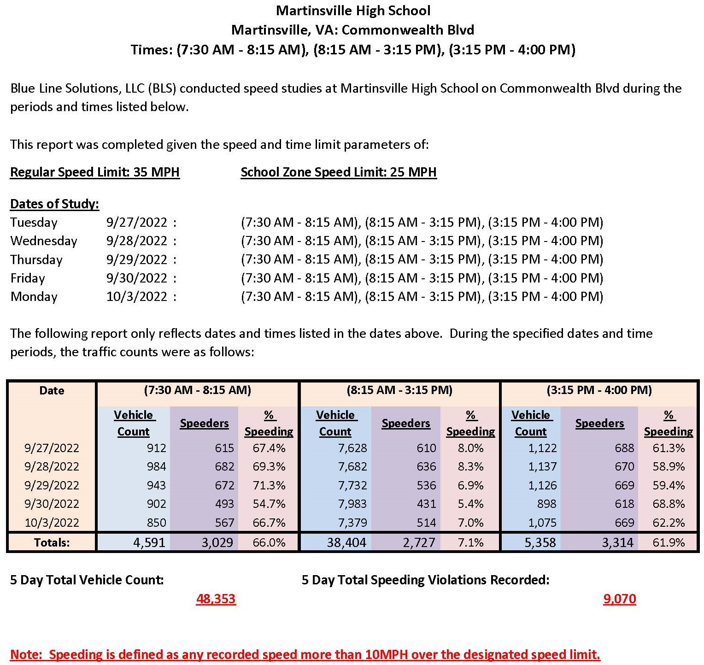
Traffic Data at Martinsville Schools

Slide 8
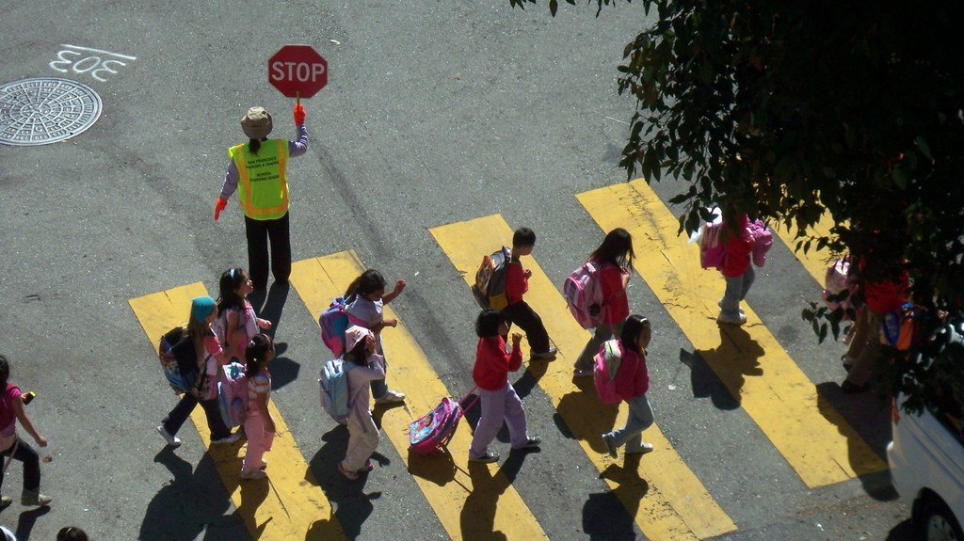
Solutions
Traditional speed enforcement in our school zones is problematic, inconsistent, and potentially dangerous.
In 2020 the Commonwealth of Virginia adopted § 46.2-882.1. Use of photo speed monitoring devices in highway work zones and school crossing zones.
This code allows localities to adopt an ordinance to use photo speed enforcement and allows for the mailing of citations for violations.
On average localities that have these systems in place, experienced a 94% reduction in violations

Slide 9
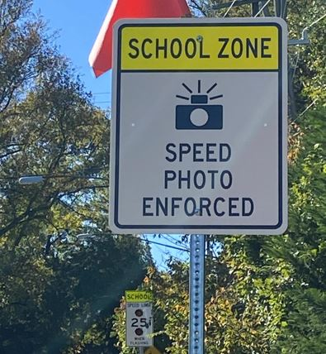
How do these systems work?
Begins with an aggressive public relations campaign.
You cannot get away or get lucky; You speed – you will get a ticket
Safety through compliance is the goal not making money
Posting of signs

Slide 10
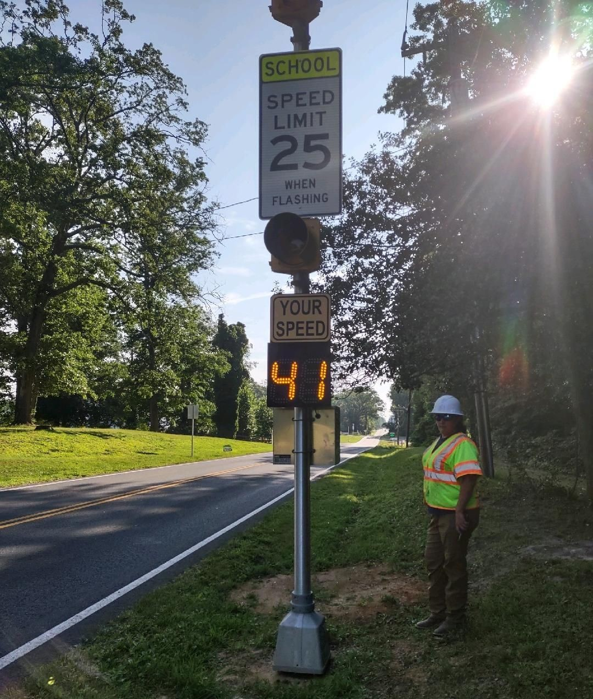
Speed Limit Signs
with flashing lights
combined with
Speed Feedback Signs

Slide 11
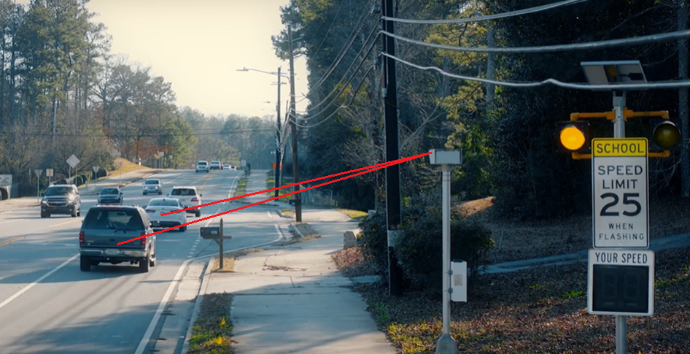
Single Lane LIDAR

Slide 12
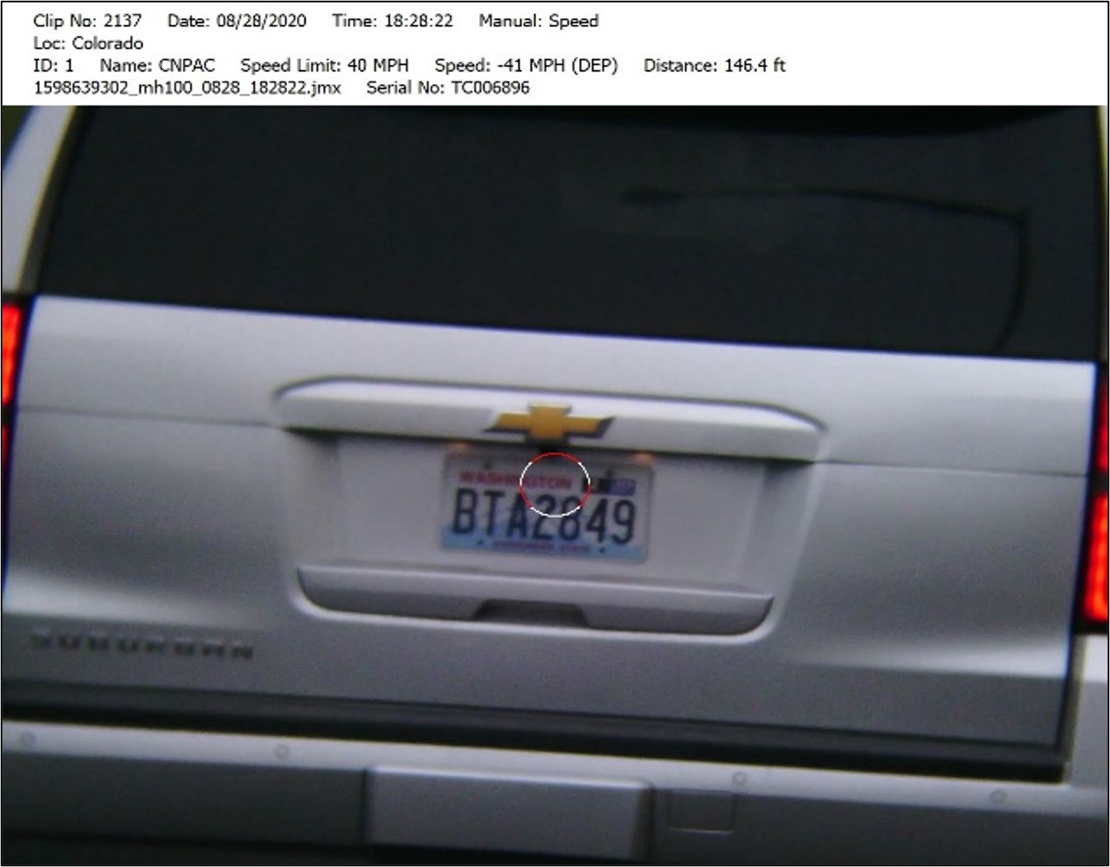
Single Lane LIDAR

Slide 13
Citations to violators
After a sworn law-enforcement officer affirms the violation, a speeding citation is mailed to the owner, lessee, or renter of the vehicle as determined by the license plate.
The violation would be a civil penalty and would not add points to a persons driving record.
To discourage repeat offenders most locations use a set fine of $100.00 per violation
People would have the right to contest the ticket and have a hearing before a judge but the vehicle owner is ultimately responsible.

Slide 14
Cost
The only cost to the city is making the Speed Photo Enforced signs
All other equipment and signs would be provided for and maintained by the partnering company – this is necessary for calibration
All software, the mailing of citations and collections of funds would be managed by the partnering company
The partnering company would charge processing fee from each ticket to cover cost. Typically $25 which $75 is sent to the city. Not classified as revenue sharing.
Although this will make money for the city, that is not the goal.
Safety is the goal!

Slide 15
Steps
Each member of council has a copy of the proposed ordinance
This has been reviewed and edited by our attorneys
Adoption of the ordinance does not obligate the city into action but allows for the next step.
If the ordinance is adopted we will further explore partnership with vendor.
All contracts will follow proper city procurement procedures and approval process.

Slide 16
Questions ?

