Slide 1
Introduction to ANCR
Supporting Communities in Assessing and Building Resilience
http://www.resilientalliance.org | @ANCResilience

Slide 2
Who is ANCR?
ANCR is . . .
a 501(c)(3), non-profit organization,
managed by the International Code Council
founded by the Code Council and U.S. Resiliency Council (USRC)
supported by Target, Dupont, and other resilience leaders
led by a board of directors representing the founders, supporters, and state and local resilience champions

Slide 3
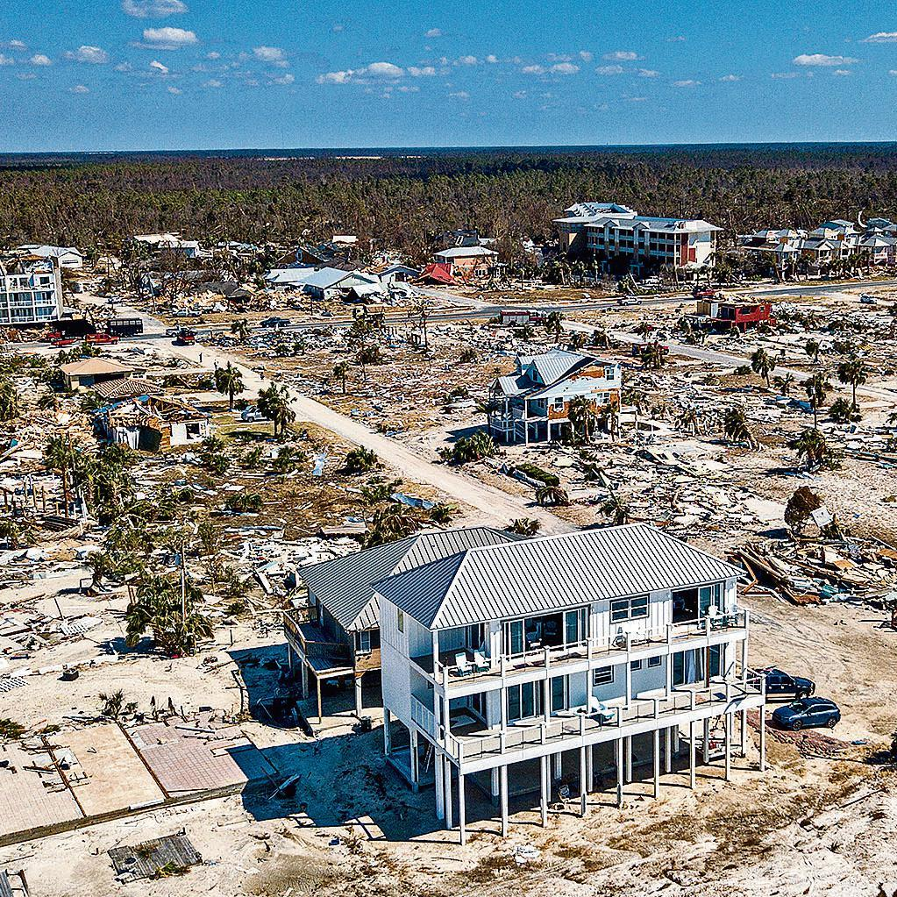
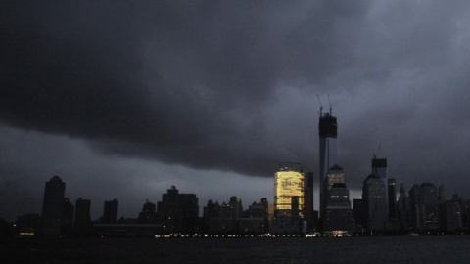
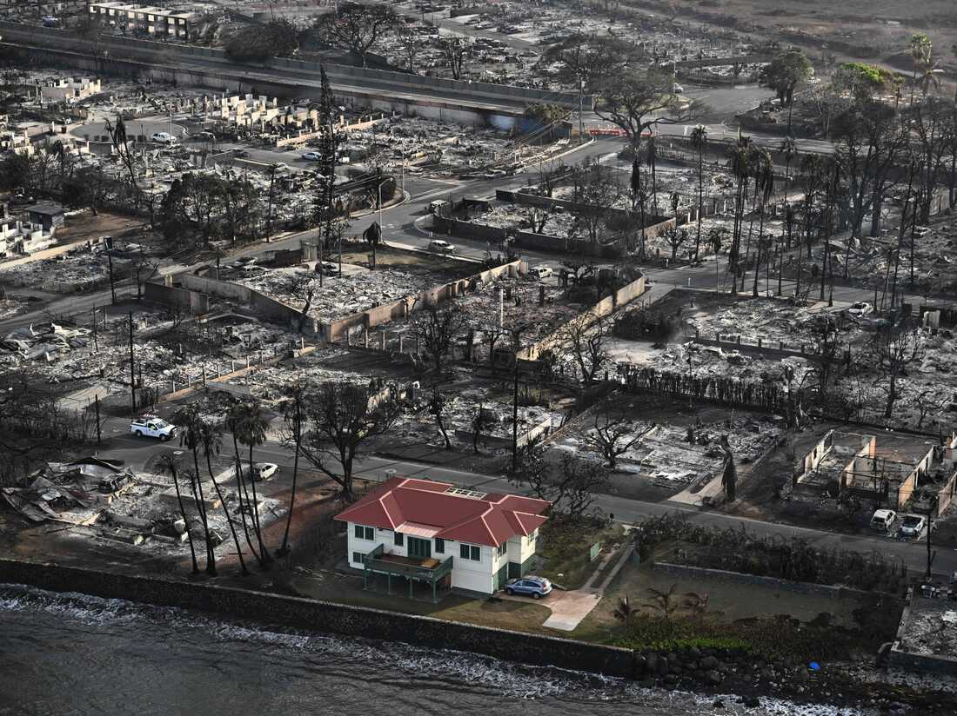

The Importance of Community-Level Resilience
Mexico Beach, FL, Post-Michael
Manhattan, Post-Sandy
Maui, Post-Lahaina Fire
Notes:
A community’s resilience (derived from the Latin resalire, to spring back) is a reflection of its ability to recover, or “bounce back” from disruptive events. When a community is “shocked” – faces a disruptive event – it experiences a loss of capacity (e.g., its ability to deliver clean water). This may be due to downed power lines, or roads washed away, or homes damaged or destroyed. Over time, the community recovers from the shock and establishes a new normal. The speed, efficiency, and effectiveness of a community’s response and recovery is a reflection of its resilience.
Communities face disruptive events ranging from natural hazards to everyday systemic challenges. Research shows that preparedness for disasters lessens damage, hastens recovery, and saves money. A widely cited study from the National Institute for Building Sciences found that every dollar spent on community resilience and preparedness can save between $4 and $11. Because increasing community resilience typically starts with strengthening existing systems, communities benefit from resilience efforts even in the absence of a disaster.
To date, many resilience initiatives have focused on individual systems and disciplines. ANCR is focused on supporting resilience at the community-wide scale. This requires understanding the various systems that make up a community, the resilience of those systems and how they come together to support the whole. ANCR looks holistically across disciplines and systems to allow communities to get a complete picture of their resilience. This helps communities assure that they are not over investing in the resilience of one segment of the community to the detriment of others or the community as a whole.
The events referenced above (and others) show the importance of looking at communities holistically. In all these cases, the building owner invested to make sure their structure was protected, but the surrounding community was not as resilient. Community resilience requires looking across the important functions of a community to assure that mitigation investments are deliberate and one segment is not being over-invested in to the detriment of others.

Slide 4
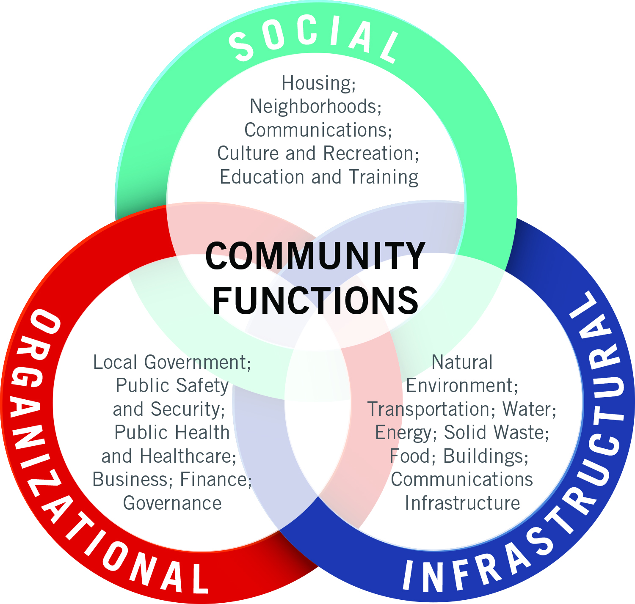
A Holistic Approach to Resilience
Notes:
Communities are defined by multiple different functions that, when operating well, create desirable places to live and work. The resilience of each of these functions contribute to the resilience of the community as a whole. ANCR has identified 19 different community functions that cut across the social, organizational and infrastructural aspects of communities. Benchmarks are being developed for each of these functions.
Unlike many current efforts, ANCR looks holistically across disciplines and systems to allow communities to get a complete picture of their resilience. This helps communities assure that they are not over investing in the resilience of one segment of the community to the detriment of others or the community as a whole.

Slide 5
The Community Resilience Benchmarks (CRBs) System
ANCR is developing a series of benchmarks for each of the 19 community functions—the Community Resilience Benchmarks (CRBs) System
The Benchmarks will provide communities with an assessment tool for community leaders to measure their community’s current resilience and determine a clear pathway toward further improvements
The assessments produced will help communities make investments and inform decisions made by local government, businesses, residents (current and prospective), and other important community players

Slide 6
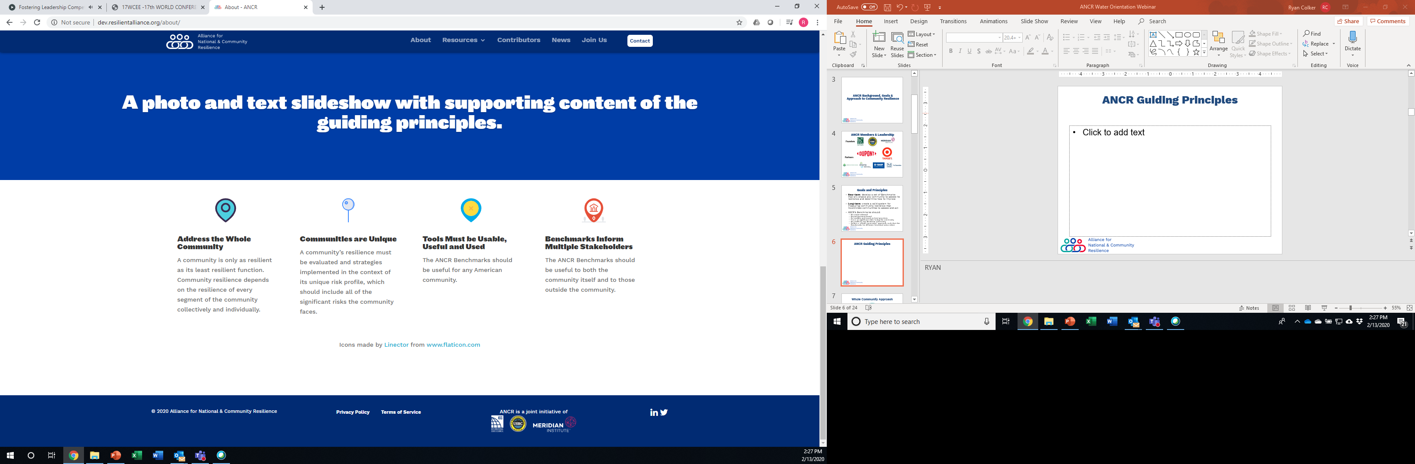
ANCR Guiding Principles
Notes:
ANCR has identified four Guiding Principles to help drive its work.

Slide 7
Developing the Benchmarks
Step 1:
ANCR Technical Staff Develops Benchmark Strawman
Step 2:
Benchmark Subject Matter Expert (SME) Committee Provides Input on Strawman
Step 3:
ANCR Staff Revises Benchmark & works with SME Committee to resolve conflicts
Step 4:
ANCR Board of Directors Votes to accept or reject Benchmark
ANCR Technical Staff creates “strawman” model benchmark based on best available science and community experience.
ANCR Technical Staff provides strawman to Benchmark Subject Matter Expert Committees for comment, suggested revision or modification.
ANCR Technical Staff curates and consolidates recommendations and prepares a final draft for approval by the ANCR Board of Directors.
The ANCR Board of Directors votes to accept, reject or modify the Benchmark. If rejected, steps 2, 3, and 4 are repeated until approval is earned.
Continuous Community Outreach and Marketing to Support Implementation
Notes:
The Benchmarks are developed through a consensus-based process that brings together subject matter experts (SMEs) to determine the content of the Benchmarks. The process starts with a strawman developed by John Plodenic based on resilience findings from a variety of sources including the United Nation’s Sendai Framework, experience from the Community and Regional Resilience Institute (CARRI) and existing codes, standards and other criteria. An SME Committee is convened to review the Strawman, provide feedback and suggest updates to the Benchmark. Once the SME Committee has reached consensus, the Benchmark is sent to the ANCR Board for approval.

Slide 8
Buildings Benchmark
Adoption of Building Codes
Administration and Enforcement of Building Codes
Licensure & Continuing Education or Testing of Contractors
Mitigation of Highly Vulnerable Buildings
Mitigation and Design of Critical Facilities
Resilient Design
Disaster Response/Continuity of Operations Plans (COOPs)
Standards for Emergency Shelters
Financial Resources for Post-Disaster Recovery
Notes:
ANCR’s first benchmark covers buildings. Buildings perform a key function in communities. Many of the other community functions rely on buildings to support the services they provide--police and fire stations support emergency response, hospitals support public health, schools support education, factories and office buildings support businesses and the economy, and houses support employees and citizens. The safety, sustainability and resilience of a community’s building stock has a direct correlation to the community’s overall resilience.
The Buildings Benchmark covers all occupiable structures in a community including new and existing buildings and both residential and non-residential/commercial buildings. This includes what may often be characterized as institutional and industrial buildings. The Buildings Benchmark focuses on the regulatory aspects of assuring the safety and resilience of the physical structures and not the policies associated with the provision of housing and the associated socio-economic factors--this topic is covered in the Housing Benchmark. Considered another way, the Buildings Benchmark is primarily focused on the activities of a code department or building department whereas the Housing Benchmark is focused on the functions associated with a housing authority or housing department.
Here are the 9 sets of requirements contained in the Buildings Benchmark.

Slide 9
Housing Benchmark
Housing Affordability & Availability
Housing Affordability: Policies
Disaster Preparedness: Communication & Outreach
Disaster Preparedness: Emergency & Temporary Shelter
Transitional & Post-Disaster Housing
Total Cost of Home Ownership/Rental
Insurance Coverage
Disaster Response/Continuity of Operations Plans (COOPs)
Equitable Long-Term Recovery from Disasters
Notes:
ANCR’s second benchmark addresses the affordability and availability of Housing. Housing is often the largest part of rebuilding after an emergency or disaster. Having a resilient housing community and plans in place before something happens can ensure the quick and timely recovery of the community as a whole and the individuals at its core. Housing also is a key determinant of the social resilience of a community.
Housing performs a key function in communities. Many of the other community functions rely on safe, affordable and resilient housing to support a workforce, provide a tax base, facilitate commerce, and reduce stresses on health care and educational systems. Safe housing enables communities to maintain economic continuity and a stable workforce throughout and after a natural hazard event. The safety, sustainability, resilience and affordability of a community’s housing stock has a direct correlation to the community’s overall resilience and the ability of a community to prepare for current and future risks.
The Housing Benchmark covers all residential structures in a community, including single family and multi-family structures. Additionally, the Benchmark addresses the differing housing needs of diverse groups, including residents with supportive housing needs, older residents, families, and congregant living facilities. The Housing Benchmark focuses on the availability of affordable housing, the quality of housing provided, the availability of shelter and transitional housing, and the continuity planning in place to ensure housing is available and maintained during a disaster. The performance of physical structures and the policies, practices, codes and standards that support them are covered in the Buildings Benchmark. Considered another way, the Housing Benchmark is focused on the functions associated with a housing authority or housing department and related agencies (including planning and community development), whereas the Buildings Benchmark is primarily focused on the activities of a code department or building department.
Here are the 9 requirements contained in the Housing Benchmark.

Slide 10
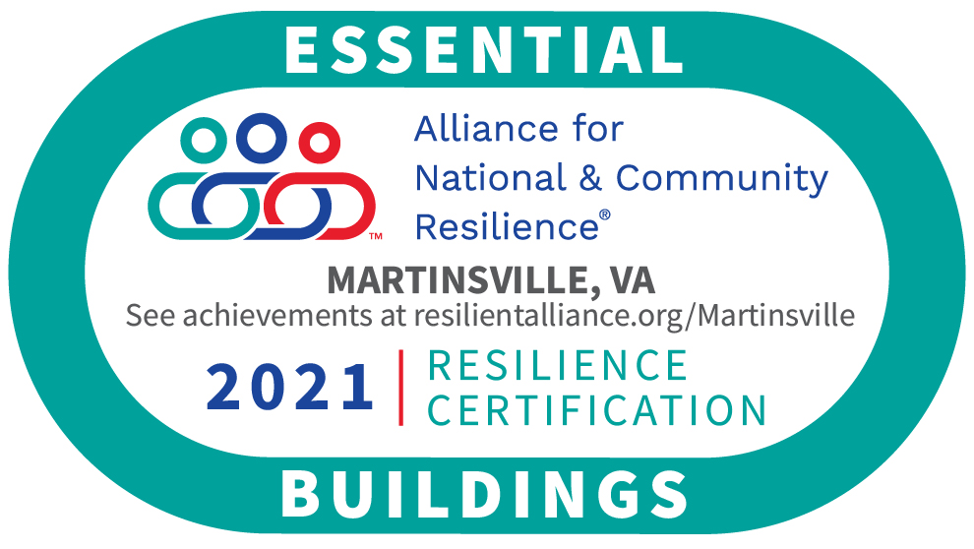
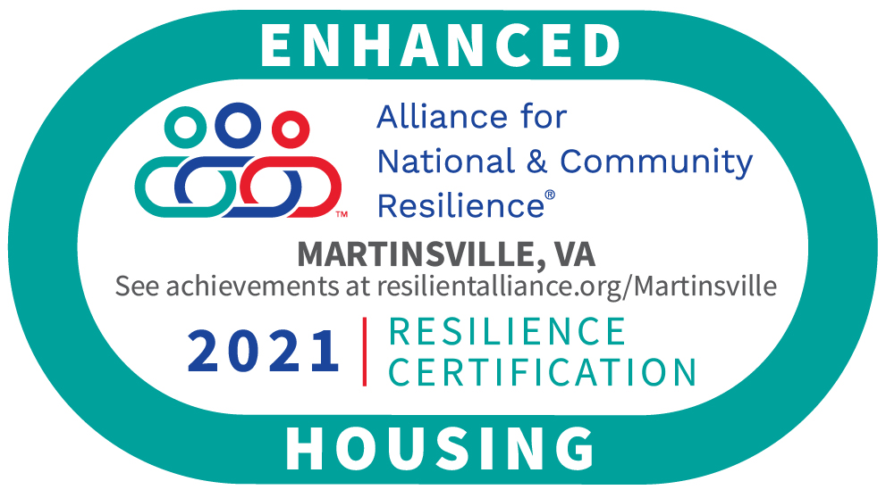
Martinsville, VA Pilot

Slide 11
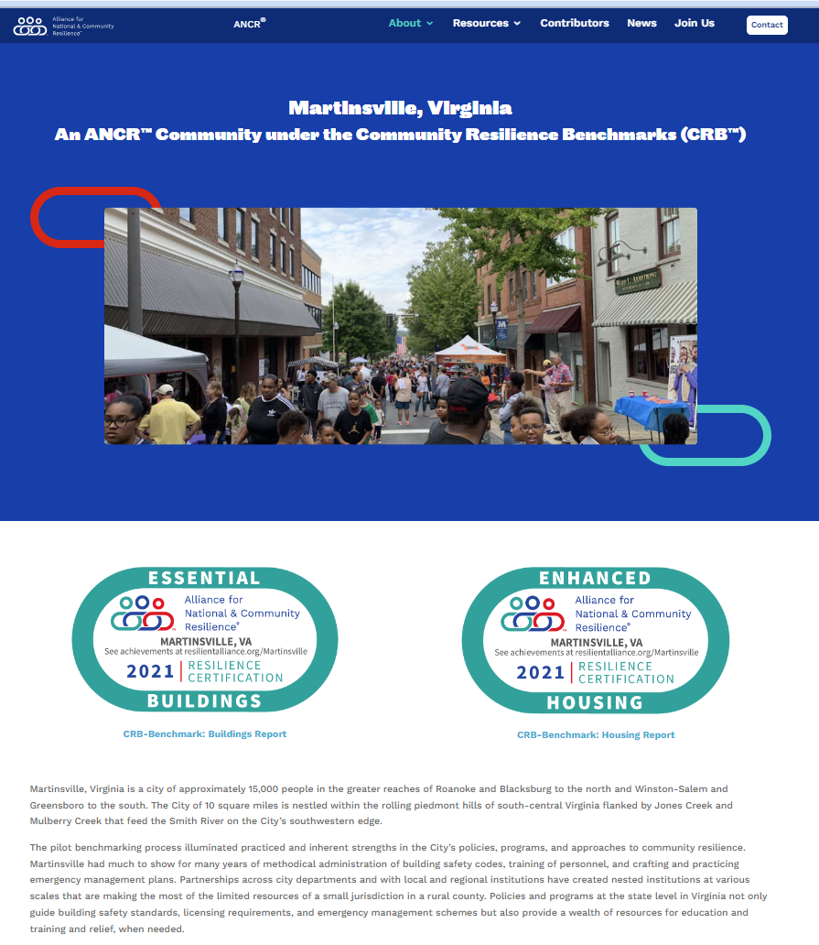
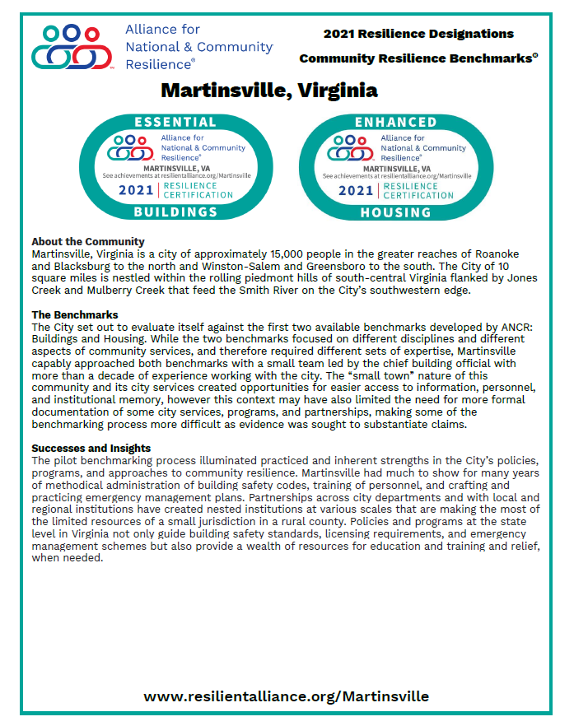
https://www.resilientalliance.org/martinsville/

Slide 12
We are Here for You. Contact Us!
Ryan Colker, Executive Director
202-596-5795 | rcolker@iccsafe.org
Alliance for National & Community Resilience
200 Massachusetts Ave, NW Suite 250
Washington, DC 20001
ANCR@resilientalliance.org
resilientalliance.org
@ANCResilience

