Slide 1

2023 ISO BCEGS report
Building Code Effectiveness Grading System
Presentation to Martinsville City Council
Tuesday, Sept 26, 2023
Department of Community Development
Kris Bridges, Building Official & Zoning Administrator

Slide 2
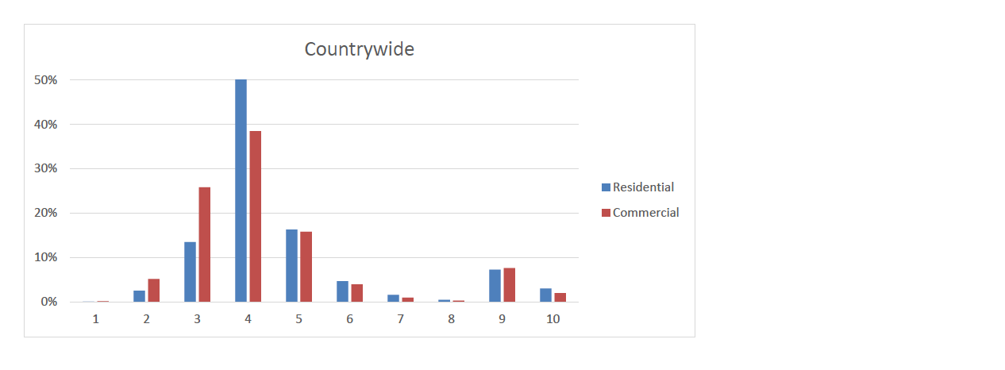
Countrywide ratings

Slide 3
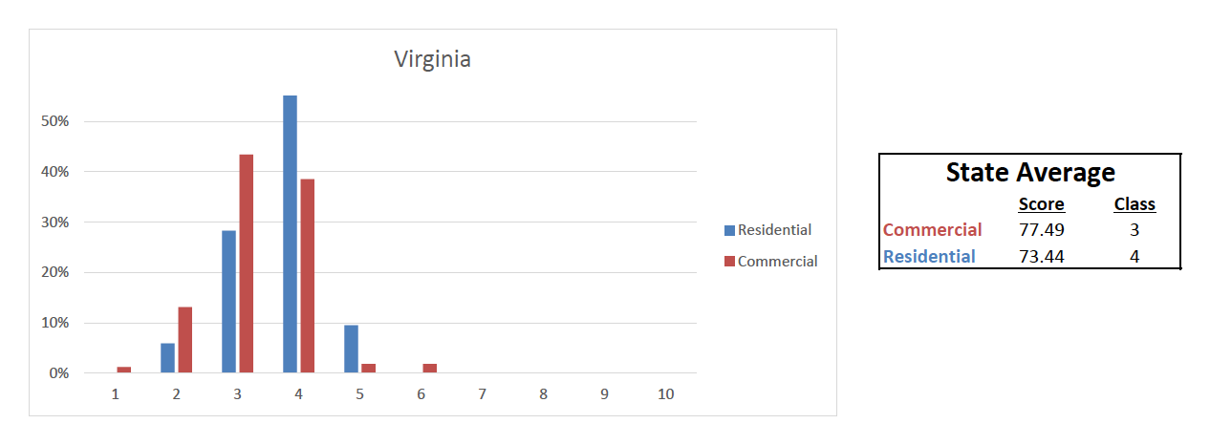
Virginia ratings

Slide 4
IBHS Rating the States
Virginia ranks #2, closely following(-1 point) Florida in the rankings of the 18 most hurricane states. The 100 point grading scale includes areas of code adoption, enforcement, and administration, Contractor licensing and training.
2021 RANKINGS
#1. Florida - 95 #10. Maryland - 78
#2. Virginia - 94 #11. Georgia - 69
#3. South Carolina - 92 #12. New York - 60
#4. New Jersey - 90 #13. Maine - 55
#5. Connecticut - 89 #14. New Hampshire - 48
#6. Rhode Island - 89 #15. Texas - 34
#7. North Carolina - 88 #16. Alabama - 30
#8. Louisiana - 82 #17. Mississippi - 29
#9. Massachusetts - 78 #18. Delaware - 17

Slide 5
Martinsville’s rating
Score Class
Commercial 91.33 2
Residential 86.57 2

