Slide 1

City of Martinsville
FY 2022-2023 Proposed Budget
April 26, 2022

Slide 2
Introduction
The proposed FY23 budget is a recommended financial plan for the City of Martinsville for the period from July 1, 2022 through June 30, 2023, and is the culmination of a process that began in late 2021 with the completion of the FY21 audit.
Developing the budget requires that both revenue and expenditures be projected for an approximate 15 - 18 month period and much can happen within that timeframe. The process is challenging and as we’ve seen in the development of prior budgets, we see many of the same key issues over and over again:
Budget requests exceeding available resources
Uncertainty regarding State fiscal policies
Best and effective use of fund and reserve balances
How best to allocate limited resources to cover a wide array of needs
Balancing adjustments to taxes, rates, and fees to adequately cover expenses with needs and what citizens can afford

Slide 3
In March of 2021, the United States Congress approved the $1.9 trillion American Rescue Plan Act with significant funding earmarked for states and localities. It was later determined that a total of $15,463,451 in ARPA funding was allocated to the City with half coming in June of 2021, and the remainder 12 months later, in June, 2022. That funding has to be committed to specific uses by December, 2024, and expended by December, 2026. In addition to ARPA funding, there is ongoing discussion at the federal level regarding additional funding programs geared toward infrastructure, broadband, and other needs.
Staff has presented information on several occasions at recent Council meetings regarding possible uses of ARPA funds and Council has voted to approve funding for several projects including improvements to Southside Park, City-wide park improvements, improvements to Hooker Field, funding for stormwater management projects, assistance with affordable housing projects, and upgrades to equipment used in the broadcast of Martinsville’s government television channel, MGTV.
Efforts are also underway to define a public process for uses of other funding in the Uptown Martinsville area.

Slide 4
As stated in previous years, funding is not unlimited – the City has finite resources and there simply aren’t enough funds available to fully fund every budget request, but there is adequate funding to cover most of what everyone needs. Striking that balance year after year is what our budgeting process has been about and through it all, the City has managed to remain fiscally sound.
The annual budget is the City’s financial plan and is the opportunity to blend Council’s vision for the future with what the citizens of Martinsville want and expect, and ultimately with the allocation of resources to turn that plan into reality. The budget process is a unique opportunity for Council, City staff, and citizens to review and shape the direction City government is headed.
As we move through the FY23 budget process, input is essential as efforts are made to create the best financial plan possible to continue moving the City of Martinsville forward into 2023 and beyond.
Leon Towarnicki
City Manager
April 26, 2022

Slide 5
FY23 Proposed Budget
General Discussion
Revenue and Expenses

Slide 6
FY22 Highlights
As discussion begins on the FY23 budget, here’s some highlights of what has occurred and continues to occur in FY22
Through a Brownfield Assistance Fund grant, cleanup of the American site on Aaron Street has been completed and Landmark has plans to start work on an approximate $10M senior living complex at that site this spring.
Pine Hall Road CDBG application was approved with work expected to begin this spring.
Redevelopment of the Chief Tassel Building in Uptown Martinsville has been completed.
Strong redevelopment interest in American Plant 10 in Uptown Martinsville (corner of Lester & Depot)
City acquired former BB&T building Uptown for redevelopment

Slide 7
FY22 Highlights
The City has executed a development agreement for reuse of the former grocery store building at the corner of Fayette & Moss Streets.
5-Points Housing Project on West Church underway
Abundant local employment opportunities.
Local transit system continues with strong usage; the Virginia Breeze system is operational.
Economic Development – Press Glass is operational; Crown Holdings construction underway; shell building in Patriot Center recently sold, CCBC continues to attract interest
$3M EDA grant for Jones Creek Interceptor Repairs
$1.5M FEMA grant for flood control at Nationwide facilities

Slide 8
FY22 Highlights
Martinsville Mustangs begins 2022 season under new management
Continued successful partnership with YMCA for management of City parks & recreation programs.
Strong local economy, strong housing/real estate market
Extensive use of grant funds to facilitate progress on local projects
Telecom/MiNet growth continues with planned expansion of wireless to the home and requests for service.
WPBDC – Incubator management continues successfully under C-PEG; incubator remains at or close to capacity
Use of ARPA funds approved for much needed projects including Southside Park, Hooker Field, and neighborhood parks.

Slide 9
Objectives
Basic Year To Year Budget Objectives Remain Constant
Maintain core services
Address critical capital needs; protect existing assets
Expand tax base
Explore opportunities to consolidate, improve efficiency, generate new revenue
Consider Council priorities in allocating resources
Ensure City remains competitive in regional workforce market

Slide 10
FY23 Budget Challenges
Lack of significant & sustained revenue growth
Increasing costs due to inflation, insurance, mandates, regulatory issues, costs of simply “doing business,” difficulty filling vacancies.
Capital needs continue to exceed available funding
School & outside agency funding
Increased costs for jail operations, transport & housing
Personnel issues – need to remain competitive with pay, benefits in order to attract/retain employees.
State not fully funding its commitments

Slide 11
FY23 Budget Challenges
Aging infrastructure
Adherence to policy requirement to maintain fund and asset balances to ensure reserve capacity to handle emergencies - recognizing that fund transfers are inevitable, ensure that reserve balances are preserved. Adoption of utility cash reserve and fund balance policies establishes guidelines on ability to transfer funds to ensure the City remains fiscally sound.
Water/sewer debt-service requirements
Limited ability to increase rates, fees, etc., and overall decreased ability to transfer from enterprise funds

Slide 12
Budget Challenges - Capital
Capital requests submitted by City departments for FY23 budget consideration totals $7,529,000 with $5,233,557 requested for utilities and $2,295,443 requested for general fund/capital reserve.
Utilities cover capital internally however the Capital Fund (16 Fund) is consistently underfunded. Outside of other transfers, the Capital Fund’s primary source of funding is available Meals Tax funds after debt service is covered.

Slide 13
Federal Funding
There continues to be considerable discussion at the federal level regarding stimulus and infrastructure plans that could potentially funnel significant dollars to the state and local levels. As discussed at previous Council meetings, the City is receiving $15,463,451 in American Rescue Plan Act funds and recommendations have been made for possible use of those funds, including use as “lost pandemic-related revenue.” As noted later in this budget presentation, ARPA funds are being used in the FY23 budget.
As additional information is made available regarding other potential funding, staff will continue to monitor and determine next steps.

Slide 14
Revenue –General Comments
What resources are available for the FY23 Budget?
Traditional sources – taxes, fees, state funding?
Fund Balance use & required minimum?
Cash reserve policies & required minimums?
Utility budgets balance internally through ability to adjust rates; General Fund budget has historically relied on utility transfers or use of fund balance, to balance.
COVID-19/Federal funding/ARPA – how much & what can it be used for?

Slide 15
Revenue GF Sources General Fund Revenue
FY23 General Fund revenue before transfers is projected to be $30,540,346. (FY22 is $28,975,888 ), from taxes, fees, recovered costs, grants, and state funding, (5.4% increase)

Slide 16
Revenue Analysis Unassigned Fund Balance- GF
Audited EOY FY21 unassigned FB is $7,574,286
FY23 proposed GF budget is $37,406,307. 10% reserve policy requirement is $3,740,630.
Available unassigned FB of $7,574,286 less FY23 reserve requirement of $3,740,630, leaves available GF FB transfer of $3,833,656 to maintain 10% reserve.

Slide 17
Revenue Analysis
Utilities – Cash Reserve Policies
EOY20 Audited EOY21 Audited Cash Reserve Policy
Electric $2,505,507 $1,253,201 $4,446,737
Water $2,628,150 $3,309,153 $1,945,107
Sewer $1,740,360 $1,982,557 $1,775,216
Refuse $4,712,005 $3,004,087 $670,196 Total $11,586,022 $9,548,998 $8,837,256

Slide 18
Revenue Analysis Available Transfer From Utilities to GF
No FY23 transfer from Electric, Water, Sewer, Refuse, or Telecom is proposed.
Electric is significantly under the recommended reserve requirement and is expected to remain so for the near future.
Water/Sewer must continue to maintain cash reserve requirements in addition to a required revenue/expense ratio related to VRA financing of debt service.
Refuse cash reserve (audited) includes required funding to comply with post-closure monitoring costs. Costs are expected to decline in the future.

Slide 19
Utilities – Cash Reserves EOY FY21 vs Current Policy Recommendation

Slide 20
General Fund - Unassigned EOY FY21 vs Current Policy Recommendation

Slide 21
Total All Funds EOY FY21 vs Current Policy Recommendation

Slide 22
Expense Analysis
What are the City’s priorities?
How should funds be allocated for education, public safety, economic/business development, capital, etc.?
Any changes in services or personnel?
Major projects?
Financing obligations and debt service?
Mandates?
How to allocate available resources efficiently, fairly, and adequately?

Slide 23
FY23 Proposed Budget
Budget Details
What’s Included?
Taxes, Rates, Fees
General Fund
Enterprise Funds

Slide 24
FY23 Proposed Budget
 |  |  |  | Changes
 | Original | Revised | Proposed | FY2022 to
Fund | FY2022 | FY2022 | FY2022 | FY2023
General | 34,218,454 | 35,545,411 | 37,406,307 | 3,187,853
Meals Tax | 2,472,720 | 2,472,720 | 2,722,721 | 250,001
Capital Reserve | 889,079 | 1,507,093 | 1,450,799 | 561,720
Refuse | 2,764,837 | 2,932,337 | 2,271,965 | (492,872)
Water | 4,670,263 | 4,753,420 | 4,255,275 | (414,988)
Sewer | 5,369,637 | 5,452,160 | 6,216,981 | 847,344
Electric | 20,833,990 | 21,982,353 | 21,356,332 | 522,342
Cafeteria | 1,737,007 | 1,737,007 | 2,293,640 | 556,633
School Operating | 23,340,713 | 23,978,640 | 27,404,205 | 4,063,492
Telecommunications | 2,377,707 | 2,377,707 | 2,195,242 | (182,465)
CDBG | 22,132 | 1,223,443 | 1,183,320 | 1,161,188
Totals | 98,696,539 | 103,962,291 | 108,757,787 | 10,060,248

Slide 25
FY23 Budget Allocations

Slide 26
FY23 Proposed Budget
The proposed FY23 budget is $108,757,787, an increase of $10,060,248 over the approved FY22 original budget.
Debt is well-managed. Existing debt service costs are covered either through project savings (AMI/Lighting and Building Energy Projects) or through fees and rates.
Budget maintains reserves in all utilities but Electric, and 10% in GF. Expenditure additions will necessitate additional revenue, reductions in proposed budget, or additional use of FB/reserves.

Slide 27
FY23 Overall Budget Drivers
Salary & Benefits
16.1% increase in health insurance
VRS (6.5%) , State Life
Cost to house inmates at other facilities
Outside Agencies
Inflation impact on fuel, materials, supplies
Projects & capital needs

Slide 28
FY23 Proposed Budget
General Fund
FY23 Proposed General Fund Budget is $37,406,307 compared to the FY22 General Fund budget of $34,218,454 , and the FY22 revised budget of $35,545,411.
The General Fund budget balances with a projected use of fund balance of $3,865,961; and use of $3,000,000 of ARPA funds; no proposed transfer from Electric, Water, Sewer, Telecom, or Refuse. Available GF fund transfer to maintain 10% reserve is $3,833,655 ; an additional $3M is necessary. Anticipate a return to FB of approximately $1.5 M at EOY22.

Slide 29
FY23 Proposed Budget
Taxes, Rates, and Fees
No recommended tax rate increases.
Includes a 7% increase in all refuse collection fees. (rates were last adjusted in July, 2013)
No other increases recommended effective July 1
Includes utilizing the anticipated increase in personal property tax revenue resulting from higher assessments

Slide 30
FY23 Proposed Budget School Funding, TROF Grant Repayment
Recommended funding for Schools at $6,170,397 which is FY21 level funding of $6,045,015 minus the Telecom e-rate contribution/adjustment of $99,624, plus $225,000 addition to offset 16.1% health insurance increase for approximately 204 School employees.
Includes final year 5 (of 5) repayment of TROF grant in amount of $156,000.

Slide 31
FY23 Proposed Budget
Continues the use of cost allocation analysis to recover expenses incurred by General Fund operations in support of the operation of City utilities (Electric, Water, Sewer, Refuse, Telecom). FY23 GF budget includes $789,608 in cost allocation revenue. This amount is included as part of utility operational costs in the respective funds.

Slide 32
FY23 Proposed Budget
Outside Agencies
Recommended level funding for most outside agencies; 911 increases 2.5% from $497,503 to $510,101; 12.0% increase in Social Services funding from $489,257 to $548,056; 19.8% reduction in funding for the Health Department from $165,654 to $132,907; EDC level at $100,000; and level Library funding $295,308. Continues small business/Uptown development at $60,000; UP at $30,000 and $39,000 for Mustangs management.
Includes one new request of $10K for Sports Authority; HC has included $20K in their budget

Slide 33
FY23 Proposed Budget
Personnel & Services
5% COLA for City employees & constitutionals; increase in health insurance costs (16.1%), VRS (6.5%); other market adjustments in PD, Fire, Sheriff, Electric, Garage, and others. Pay plan adjustment of 9% to address compression results in approximately 40 employees with additional adjustments up to 4%.
Includes 3 personnel additions – one in Street Marking & Signs; 2 in Refuse Collection; reduction of 2 positions in PD (one sworn/one civilian); one in Senior Services as programs are eliminated and SS provides transportation-only services
There are still a number of vacant/unfilled positions.

Slide 34
FY23 Proposed Budget
Ambulance Transport Services
In July, 2021, Council approved Fire/EMS to proceed with ambulance transport services of discharged hospital patients. City purchased an ambulance and brought additional staff on board. Operation currently averages around 13 transports per week and at anticipated billing rates, revenue (estimated at $168K) will exceed costs ($104K).
Operation continues to be closely monitored and if transport numbers decline and/or actual billing receipts do not support program costs, City can terminate the program. There is added benefit to the City by having additional staff & equipment available for City needs.

Slide 35
FY23 Proposed Budget
Capital (equipment, vehicles, projects, etc.)
Funding of Capital Reserve (16 Fund) in the amount of $1,450,799 is proposed; of this amount, $361,349 is required for debt service and the balance of $1,089,450 will be assigned to capital purchases on a prioritized basis by the capital review committee.
This amount funds 47% of the capital (non-enterprise) fund requests of $2,295,443. Capital is funded through Meals Tax revenue after school and capital debt is covered.

Slide 36
Capital – Enterprise Funds
Capital (equipment, vehicles, projects, etc.)
In the enterprise (utility) funds, $1,464,306 is included in the respective fund budgets to address capital and equipment needs. Included in the enterprise funds are Refuse (09), Telecom* (11), Water (12), Sewer (13), and Electric (14).
* Through the City’s annual audit process, Telecom is not identified as a separate enterprise fund although for internal City budgeting and tracking purposes it is considered and programmed as such. Telecom is a component of the General Fund.

Slide 37
FY23 Proposed Budget
Refuse (09)
Proposed budget includes a collection fee increase of 7% across all refuse collection fees.
FY23 includes funding for all full-time staff on collection trucks, increase in disposal costs, and moving costs and operation of the landfill generator to electric as a peaking unit. Capital includes year 1 of 2 cost ($175K) of replacing ‘05 front loader truck.

Slide 38
FY23 Proposed Budget
Telecommunications (11)*
The projected FY23 Telecom budget is $2,195,242 and includes $74,732 under a cost allocation analysis going back as revenue to the GF. $397,899 is included in capital for a continuation of system upgrades, expansion to additional customers, and wired/wireless-to-home project.
A business plan has been developed for the residential expansion project. The Clark Road project is planned as a residential pilot project and experienced delays due to supply chain issues regarding certain equipment, but is expected to begin shortly. The results of the pilot project will be used as data for the business plan. It is anticipated that grant funding sources will be investigated for FTTH expansion.
*Telecom is listed as a separate (11) fund to simplify internal accounting but is actually a component of the General Fund

Slide 39
FY23 Proposed Budget
Water (12)
Reservoir project has been completed
Water/Sewer construction crew continues to make infrastructure repairs at substantial savings over contract costs.
Grant application has been submitted for reservoir generator (20% local match)
$104,000 in capital for various projects
Possible requirement to determine usage of lead pipe in water system.

Slide 40
FY23 Proposed Budget
Sewer (13)
The Sewer budget includes capital funding ($127,207) to replace a pump and convert to a sodium hypochlorite tank/feed system.
Budget includes $500K for 20% EDA Grant match for Jones Creek project.
Annual debt service for the interceptor rehab project is included at $634,336.
Long term project being investigated is in regard to sludge process at waste water plant and reduction of disposal costs.

Slide 41
Water/Sewer Projects
YEAR | STREET (s) | WATER | SEWER | STATUS
2022-2023 | LAKEMONT CT | 1400
2022-2023 | FOREST ST PT2 |  | 1750' |  |  | INCLUDE LATERALS
2022-2023 | AUBURN PL | 1200' |  |  |  | ON HOLD, PIPE ORDERED
2022-2023 | VENNA AVE/EDWARDS | 3500' |  |  |  | GALVANIZED, IN BAD SHAPE
2022-2023 | FOREST ST PT1 |  | 1750' |  |  | INCLUDE LATERALS
2023-2024 | BARTON |  | 1000'
2023-2024 | ASKIN |  | 2000'
2024-2025 | AMY |  | 700'
2024-2025 | LAKEVIEW TR | 1500'
2024-2025 | D ST | 500'
2025-2026 | CORN TASSEL | 3600'

Slide 42
FY23 Proposed Budget
Electric (14)
No proposed electric rate increase effective July 1
Electric budget capital ($660,200) year 2 of 2 funding a 55 foot bucket truck and 1 of 2 on second truck; station transformers; line replacements, increased costs for flood insurance, tree trimming, generator fuel, dam repairs
FY23 Electric budget is $21,356,332 and the purchased power item is $16,068,000, the largest single line item expense in the City’s budget, and represents 75.2% of the Electric budget.
Battery storage project is starting up; may be delays on solar due to supply chain issues; possible long term projects - investigate an alternate electric feed to City; work at hydroplant (dredge & replace turbines)

Slide 43
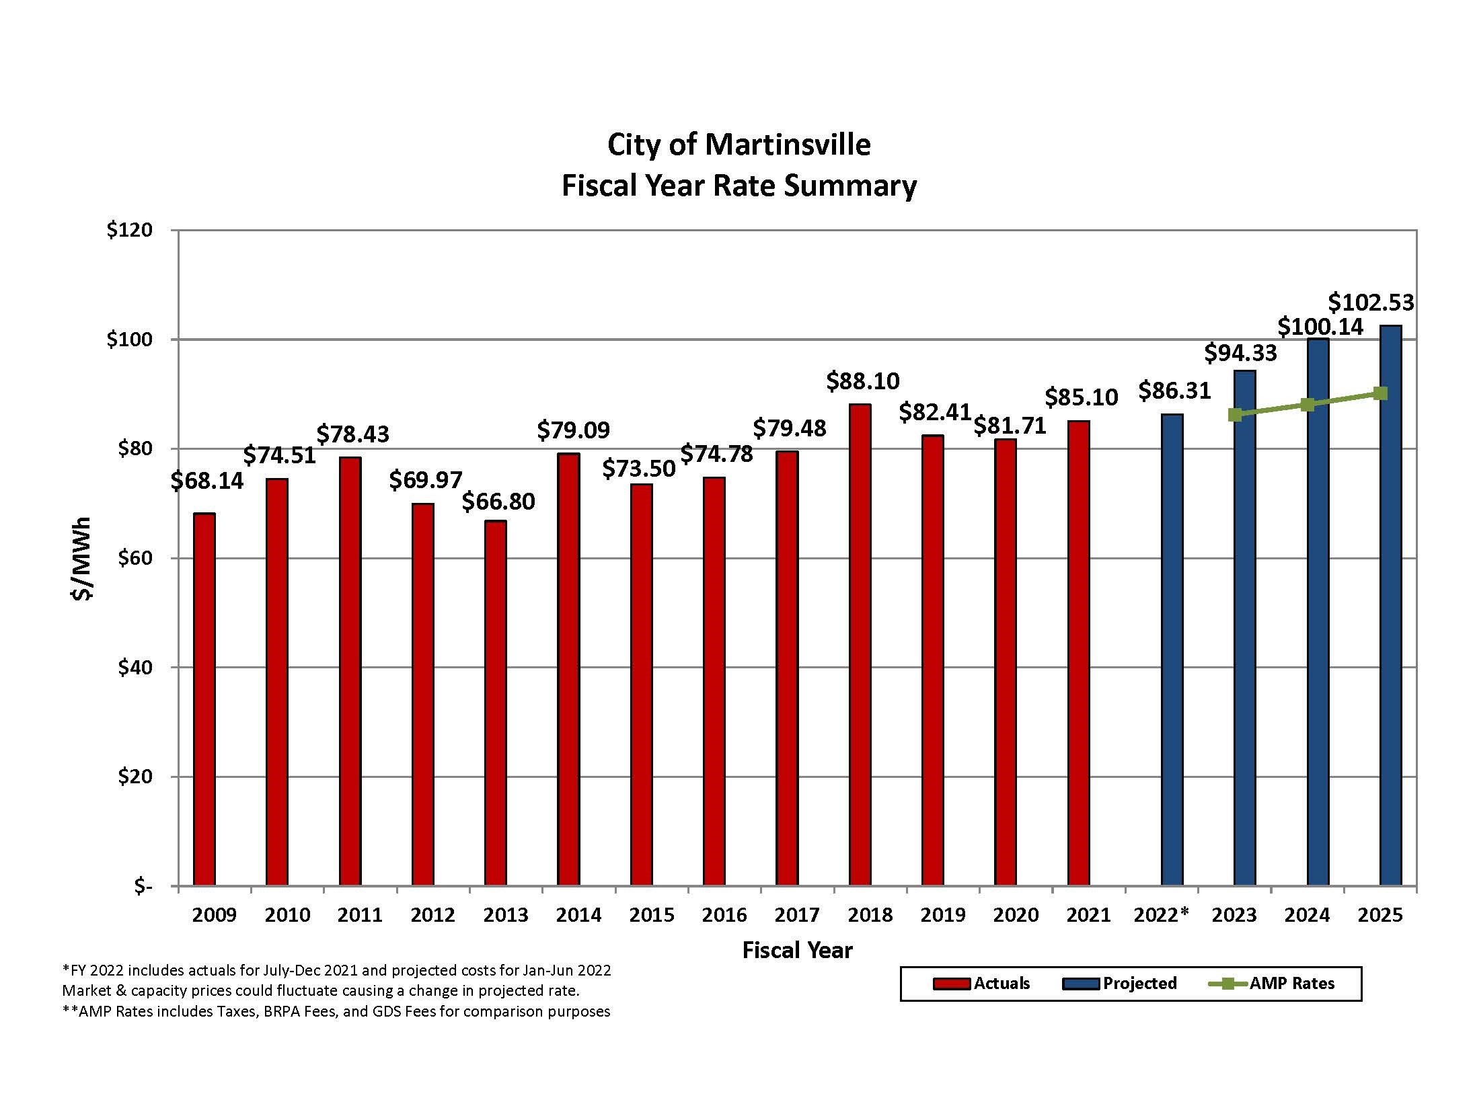

Slide 44
Comments and Conclusion
The FY23 budget continues the practice of the enterprise operations balancing internally, utility fund transfers when available to help balance in the GF, and use of FB as available, all while attempting to keep policy-directed minimum balances and reserves intact.
That process, however, is getting increasingly difficult while attempting to maintain reserves, without increasing revenue, reducing services, or combinations. Of particular importance is the fact that the FY23 General Fund budget contains a funding gap between revenue and expenses of $6,865,961, and that gap is closed by use of fund balance and ARPA funds.

Slide 45
Comments and Conclusions
The budget as presented is proposed, and over the coming weeks Council will have an opportunity to make changes as it deems appropriate. Throughout the process, staff will provide support and additional information as needed, and ultimately will take the budget adopted by Council and implement that plan to the best of its ability.

Slide 46
Comments and Conclusion
As always, our department staff, constitutional offices, and schools put significant effort into the budget process and much credit and thanks goes to them for their efforts. As in previous years, the budget requests were found to be reasonable and needed, and Council will have an opportunity through the upcoming work sessions to ask questions.
As always a special thanks goes to Linda Conover and Mandy McGhee of the Finance Department for their work throughout this process.
# # # # # # #

Slide 47
Next Steps
Review the budget details, request additional information, ask questions, and talk with citizens.
Three work sessions have been scheduled – April 27 for Schools, City departments, and capital; May 3 for City departments, constitutionals, outside agencies; and May 4 for follow up, and additional discussion as may be needed.
Consider setting a public hearing on the FY23 Budget for Council’s May 10, 2022 meeting.

